Slide 1
WISCONSIN
ARMY
NATIONAL
GUARD
Federal Tuition Assistance (FTA)
2LT Jolene Anders
jolene.a.anders.mil@army.mil
608.242.3449

Slide 2
Agenda
WIARNG Education & Incentives Office
Overview
Eligibility
FTA Process for Students
Recoupment & Waivers
Common Issues
Student / AI Support
Questions / Discussion

Slide 3
WIARNG Education & Incentives Office
Education Personnel:
Education Services Officer – LTC Joy Staab
Education / Incentives NCOIC – SFC Tom Render
Education Services Specialist / GI Bill Manager – LT Jolene Anders
Key Education Functions:
Education benefit counseling and information.
Establishing Chapter 1606 & Kicker eligibility.
Assistance with Post 9/11 GI Bill eligibility and Transfer of Education Benefit (TEB) issues.
Complete military portion of WING Tuition Grant applications.
Incentives: Process payments for bonuses and Student Loan Repayment (SLRP).
Notes:
Every state has an office like ours – we can get you in contact with the appropriate state.

Slide 4
Overview
FTA will fund up to $4,500 per fiscal year (October 1st – September 30th) towards tuition.
FTA is always subject to the availability of funding.
Limitations:
Maximum 18 semester hours per fiscal year.
Up to $250 per semester hour ($166 per quarter hour, or $5.55 per clock hour).
130 lifetime undergraduate semester hours.
39 lifetime semester hours towards a master’s degree (not eligible for doctorate).
21 lifetime semester hours towards an undergrad or graduate certificate (limited to one per career).

Slide 5
Eligibility
Be in good standing and has a CAC card (completion of initial entry training is no longer required).
Cannot be flagged (i.e. fitness test failure, misconduct, not meeting height/weight standards).
Must maintain a 2.0 GPA for undergraduate degrees after 15 SHs of coursework; 3.0 GPA for graduate degrees after 6 SHs of coursework.
Cannot pursue an equivalent degree to one already earned (i.e. a second bachelor’s degree).

Slide 6
FTA Process for Students
FTA requests must be approved no later than 7 days before the course start date. Students can apply up to 60 days before.
Step 1: Watch the ArmyIgnited (AIED) 101 training video (15 minutes) on YouTube.
Step 2: Log into ArmyIgnited and create a message (education goal or degree plan can be selected as the category) stating the date you completed the AIED 101 training video.
Step 3: Complete the Career Interests Assessment in DANTES Kuder Journey (this replaced Career Path Decide). Upload the one-page summary to ArmyIgnited.
Step 4: Get an individual degree plan (i.e. degree audit report) from your institution.
Step 5: Create an Education Goal.
Step 6: Once the Education Goal is approved, tuition assistance requests (TARS). Each individual course should have a separate funding request.
*Soon students will require Commander approval to use FTA. More guidance pending.*

Slide 7

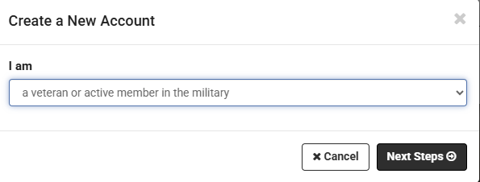
DANTES Kuder Journey (1/4)

Slide 8
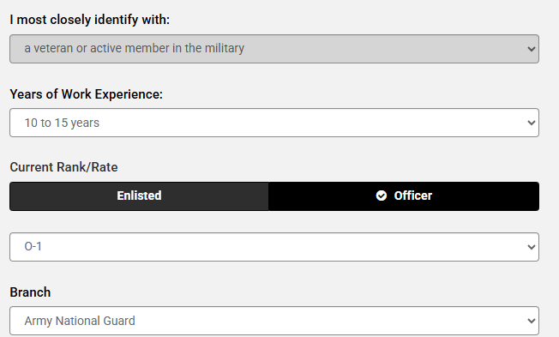
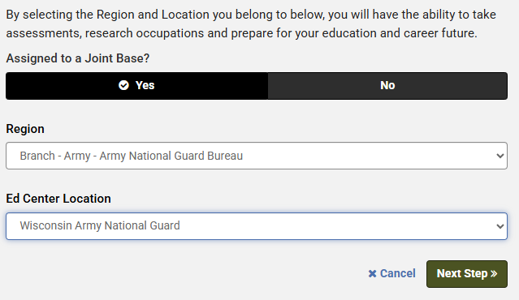
DANTES Kuder Journey (2/4)
*After selecting their Education Center, students will fill out their personal information and provide an email address.

Slide 9
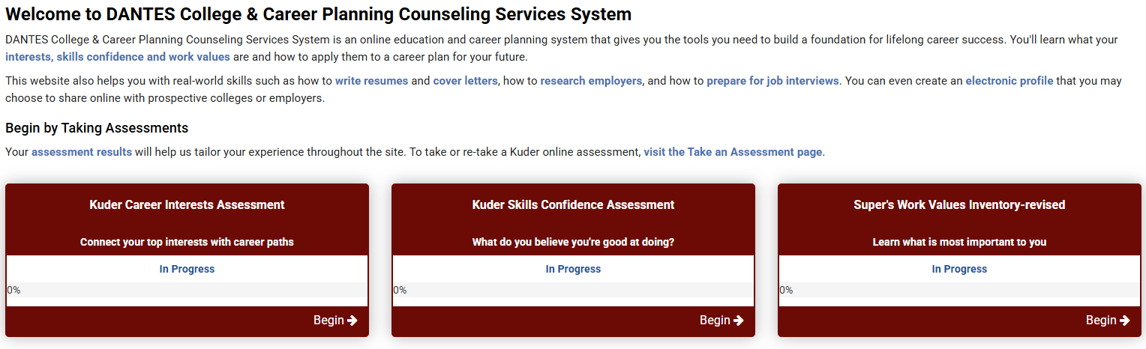
DANTES Kuder Journey (3/4)
*Students only have to complete the Career Interests Assessment.

Slide 10
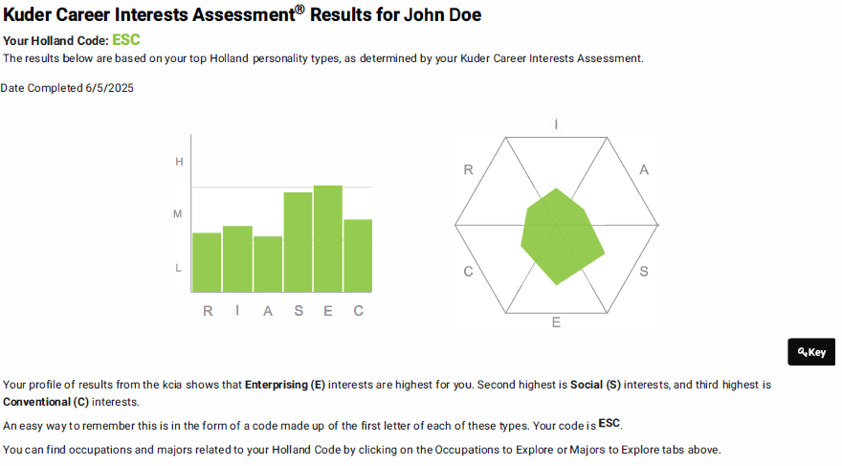
DANTES Kuder Journey (4/4)
*Students will download their one-page summary and upload it to ArmyIgnited under Career Path Decide.

Slide 11
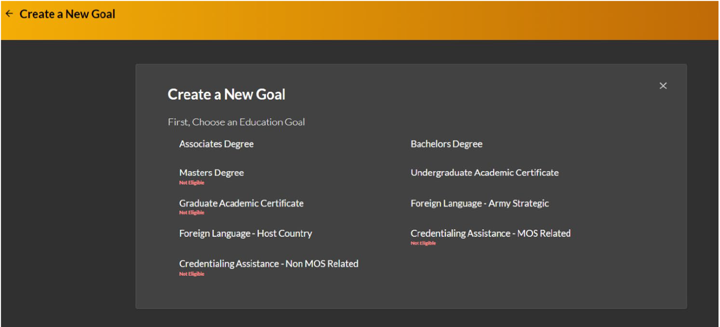
Education Goal (1/5)

Slide 12
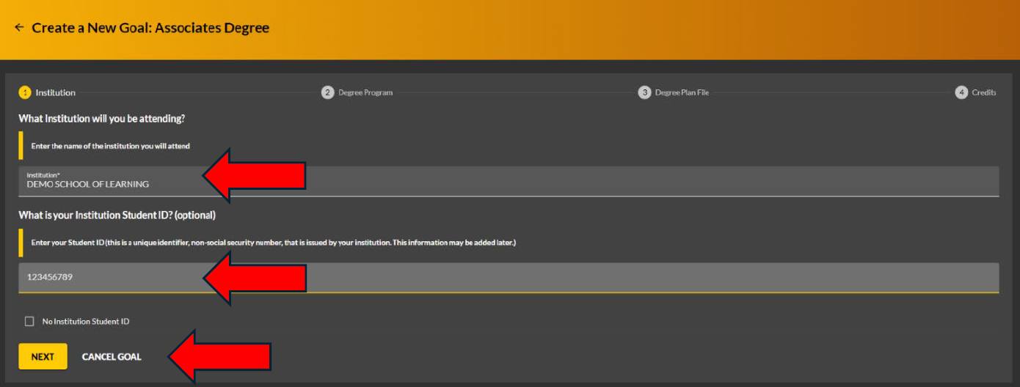
Education Goal (2/5)

Slide 13
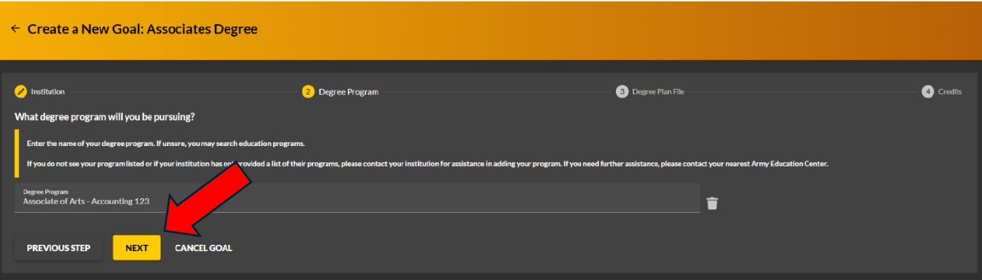
Education Goal (3/5)
*Students can only select Degree Programs that have been created through your AI Portal. If newer programs haven’t been added, the student won’t be able to submit a goal for it.

Slide 14
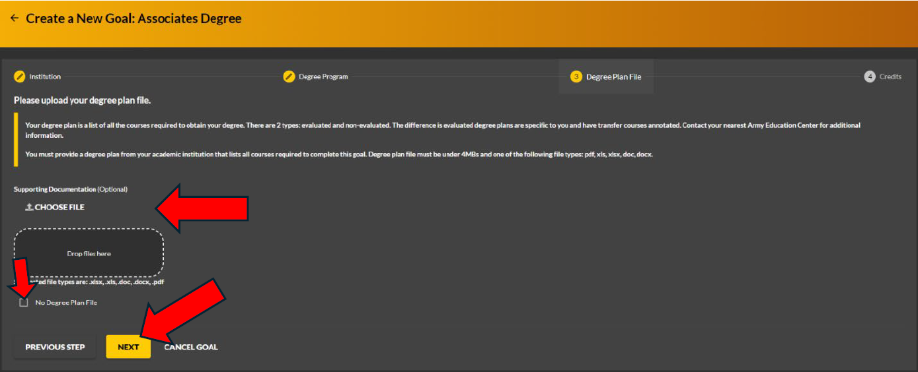
Education Goal (4/5)
A valid degree plan must include the student’s name, student ID number, degree program, transfer credit awarded, and progress towards degree – basically, the degree audit report.
Degree plans are required after the completion of two courses, but it’s recommended to submit right away. Students can’t upload degree plans after the education goal has been created, they have to send it to our office.

Slide 15
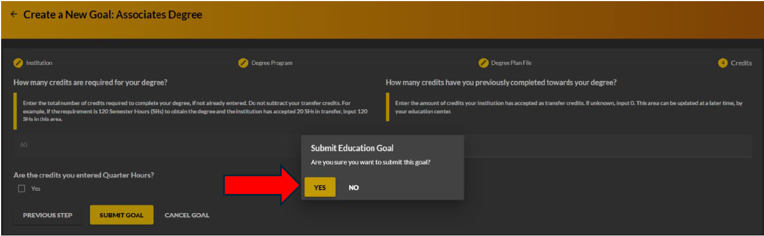
Education Goal (5/5)

Slide 16
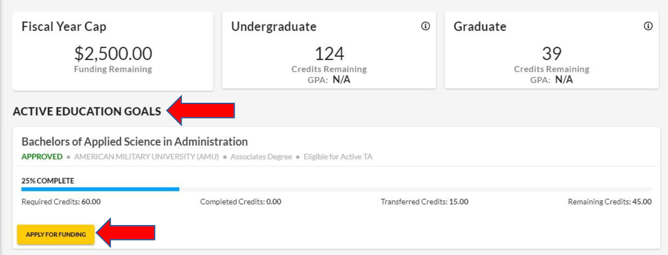
Tuition Assistance Requests (1/8)

Slide 17
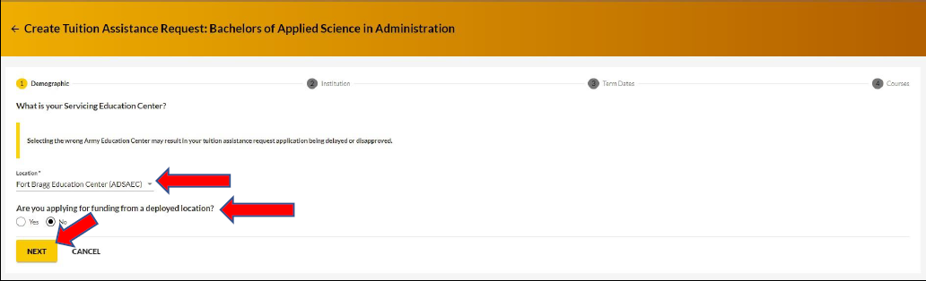
Tuition Assistance Requests (2/8)
*Students will be asked to verify contact information and agree to the User Agreement before seeing the prompt below.
Education Center is: ARNG-Wisconsin Education Services Office
Notes:
Verify current ‘Education Center’, identify if ‘deployed’ then select ‘Next’:

Slide 18
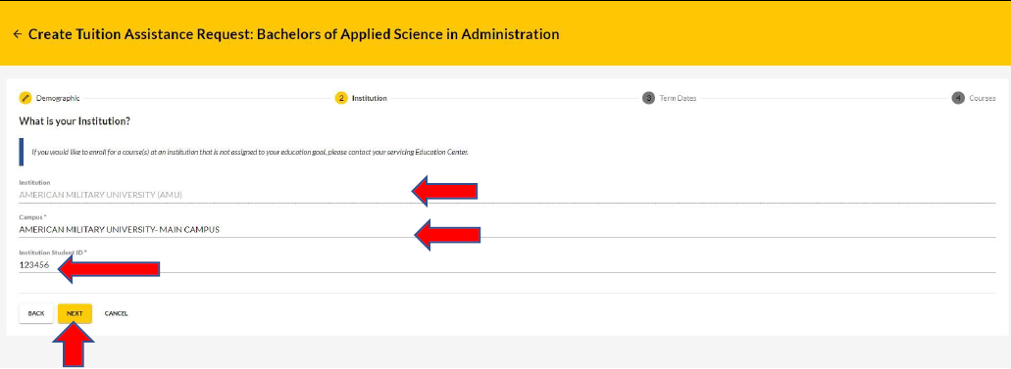
Tuition Assistance Requests (3/8)
Notes:
Verify ‘Education Institution’ is correct; ensure correct ‘Campus’ is selected; input ‘Institutional Student ID’ then click ‘Next’:

Slide 19
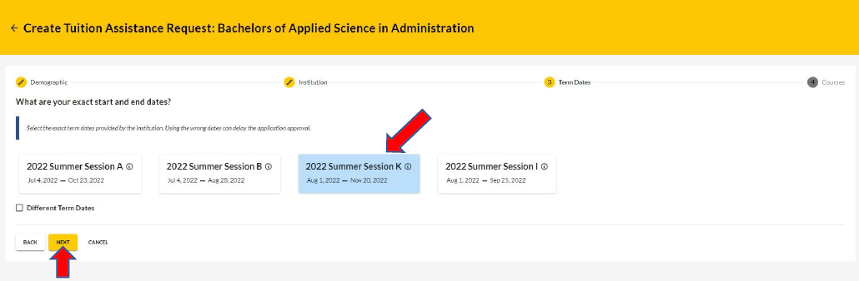
Tuition Assistance Requests (4/8)

Slide 20
Tuition Assistance Requests (5/8)
*If dates are not listed, students can select “Different Term Dates” and input them.

Slide 21
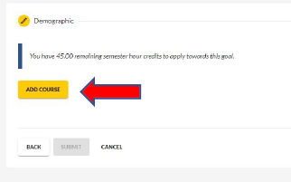
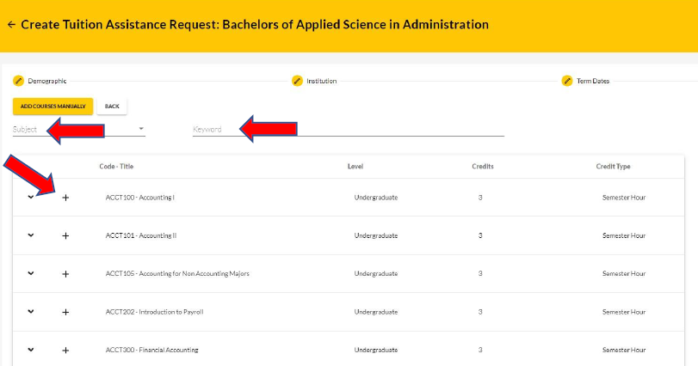
Tuition Assistance Requests (6/8)
*If dates are not listed, students can select “Different Term Dates” and input them.

Slide 22
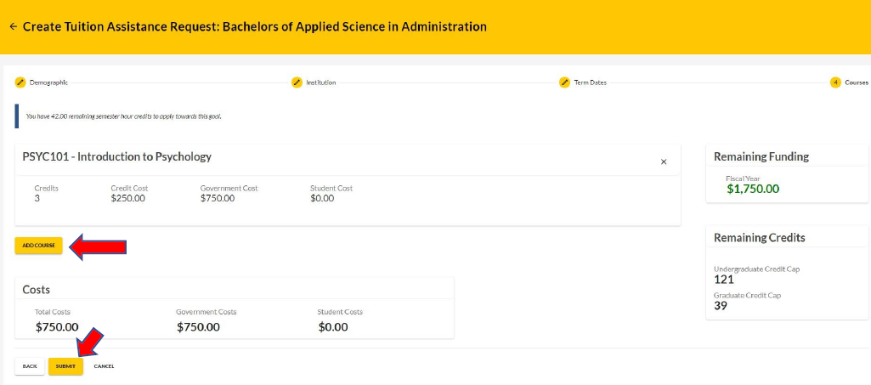
Tuition Assistance Requests (7/8)
Notes:
Courses will show students their cost versus what the government is paying. Click on ‘Add Course’ if you want to add another course; otherwise click ‘Submit’:

Slide 23
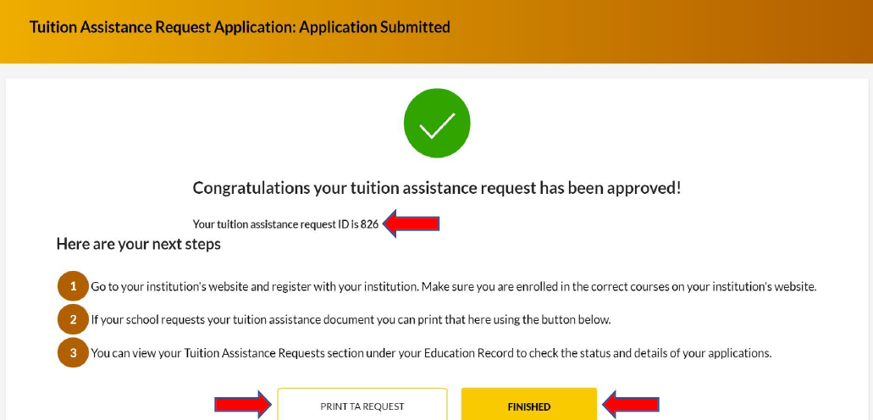
Tuition Assistance Requests (8/8)
Notes:
Click on ‘Add Course’ if you want to add another course; otherwise click ‘Submit’:

Slide 24
Recoupment
Soldiers will be subject to recoupment if they:
Receive a failing grade.
Grades D- & F for undergraduate degree
Grades C-, D, & F for graduate degree
Receive an incomplete for the course and do not complete requirements within 180 days.
Withdraw from a course without an approved recoupment waiver (see next slide)
Do not complete their Military Service Obligation (MSO) after the course end date:
Enlisted Soldiers must have 60 days remaining on their contract.
Traditional drilling officers have a 4-year MSO.
Active Guard Reserve (AGR ) / Active-Duty officers have a 2-year MSO.

Slide 25
Recoupment Waivers
Recoupment waivers must be submitted within 30 days of a “W’ grade input in ArmyIgnited.
Students receive a message in ArmyIgnited notifying them of a potential recoupment and suspense for waiver submission. All waiver submissions are done in ArmyIgnited.
Waivers will only be considered for the following reasons:
Short notice permanent change of station or temporary duty after course start date that prevents attendance at an in-person class.
Emergency leave.
Emergency health issues.
Hospitalization of a length to preclude course completion, and the academic institution disapproved an extension.
Short notice changes in work schedule that interfered with course attendance and completion.
Recoupment deductions are taken out of the student’s military pay. They will begin automatically after the suspense date if a waiver is not initiated.

Slide 26
Common Issues
Students not reading their ArmyIgnited messages.
They are notified via their military email when a new message is sent in ArmyIgnited, but most don’t have access to this email.
Incorrect personnel data (i.e. contract end date, civilian education level, flags).
Waiting too long to start the FTA process. There is no waiver process for missing the 7-day deadline prior to classes starting.
Not understanding the full application process.

Slide 27
Student Support
First: WIARNG Education & Incentives Office, 2LT Jolene Anders
Office mailbox: ngwi.edu@army.mil
Direct: jolene.a.anders.mil@army.mil
Phone: 608.242.3449 or x3448
Second: Send a message in ArmyIgnited.
Third: Mr. Joshua Fenner – Education Services Specialist in Michigan.
Phone: 517-481-8107
AIED Technical Issues:
BAM Helpdesk Phone: 276-231-0938
BAM Technical Issue Email: army@bamtech.net

Slide 28
Academic Institution Support
School Support:
https://vantagepoint-inc.com/armyschoolsupport
Knowledge Community:
https://military-school-support.mn.co/

Slide 29

Closing
Questions / Discussion

