Slide 1
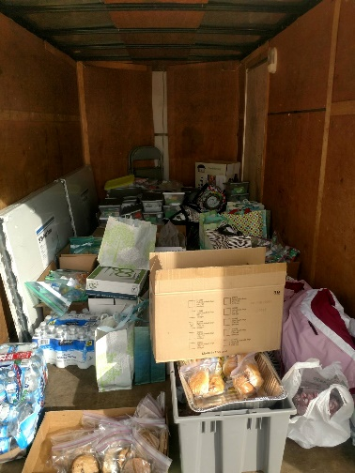
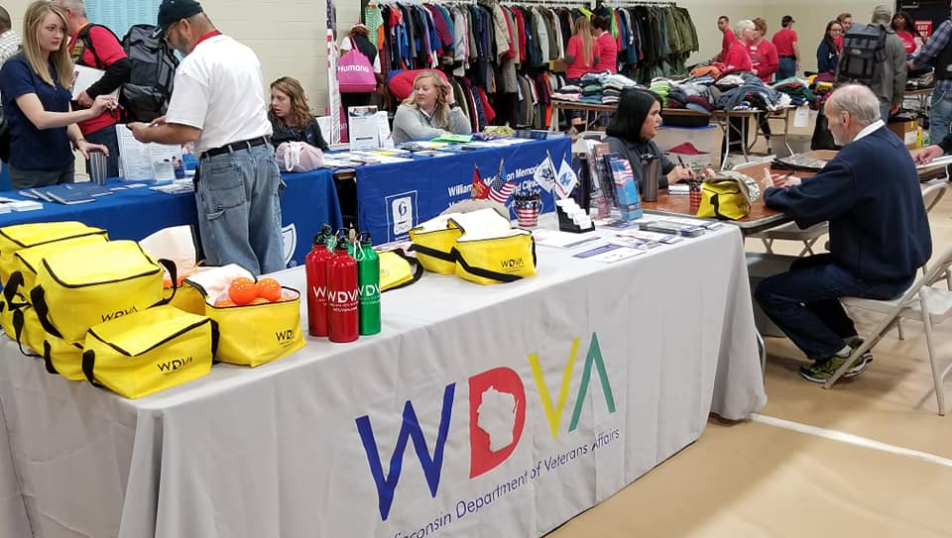
WISCONSIN DEPARTMENT OF VETERANS AFFAIRS James Bond, Secretary

Slide 2
Bureau of Health Services
Jenny Fahey- Director of Bureau of Health Services
Veteran Outreach and Recovery Program (VORP)
__________________
Program Supervisors:
Chandler Miller (Team South)
Cal Stammer (Team North)
Veteran Housing and Recovery Program (VHRP)
_________________
Contract Specialist:
Trish O’Reilly

Slide 3
The mission of the Wisconsin Department of Veterans Affairs is to work on behalf of Wisconsin's veterans' community — veterans, their families and their survivors — in recognition of their service and sacrifice to our state and nation.​​​
VORP Mission: Serving those who served, where they are, to inspire change at the individual and community level.
VHRP Goal: To help veterans achieve stability, increase skill level and/or income, and obtain greater self determination that will enable them to reintegrate back to the community.

Slide 4
Myths
Myth 1: Veterans are a small subset of the population.
Federal data show veterans make up 8 percent of the U.S. population.
Myth 2: Veterans join the military because they could not get into college and are uneducated.
35 percent of post-9/11 veterans have a bachelor’s degree or higher, compared to 31 percent of all veterans and 32 percent of the general U.S. population.
Myth 3: All veterans are eligible for VA Health Care.
Only 40% of those that serve in the Military are eligible for VA Services.
Notes:
Myth 1: Veterans are a small subset of the population.
The number that’s often thrown out is 1 percent, but that applies to active duty troops, researchers said. As of 2017, federal data show veterans make up 8 percent of the U.S. population, with post-9/11 veterans the fastest growing group among them.
Myth 2: Veterans join the military because they could not get into college and are uneducated.
According to federal data collected in the 2017 Current Population Survey, 35 percent of post-9/11 veterans have a bachelor’s degree or higher, compared to 31 percent of all veterans and 32 percent of the general U.S. population.
Rosalinda Maury, a researcher with the Syracuse Institute for Veterans and Military Families, said education benefits tend to be a top recruiting incentive, and the military promotes and prepares service members for post-secondary education.
Myth: 3 All veterans are eligible for VA Health Care
Only 40% of those that serve in the Military are eligible for VA Services.

Slide 5
Why People May Not Identify as a Veteran?
“Have you ever served in the military?” vs. “Are you a veteran?”
Don’t want to fall into the stereotypes
Non-combat
“Bad Paper”
Gender, Sexual Identity
Reserves and National Guard
Notes:
Don’t want to fall into the stereotypes: PTSD, damaged goods, gun-waving, outraged
Non-combat: Military fraught with hazardous, psychologically taxing assignments that don’t involve direct combat
“Bad Paper”
Actual quotes said to female veterans - “You don’t qualify because veterans are men.” “Being married to a solider doesn’t make you a veteran.” “Thank your husband for his service.”
Don’t Ask, Don’t Tell
Trauma

Slide 6
Why People May Not Identify as a Veteran?
“Have you ever served in the military?” vs. “Are you a veteran?”
Don’t want to fall into the stereotypes
Non-combat
“Bad Paper”
Gender, Sexual Identity
Reserves and National Guard
Notes:
Don’t want to fall into the stereotypes: PTSD, damaged goods, gun-waving, outraged
Non-combat: Military fraught with hazardous, psychologically taxing assignments that don’t involve direct combat
“Bad Paper”
Actual quotes said to female veterans - “You don’t qualify because veterans are men.” “Being married to a solider doesn’t make you a veteran.” “Thank your husband for his service.”
Don’t Ask, Don’t Tell
Trauma

Slide 7
Screening
Ensure that veterans have access to the health care and support services that they have earned
Awareness strengths and unique challenges
Ask client if close family members have served in military

Slide 8
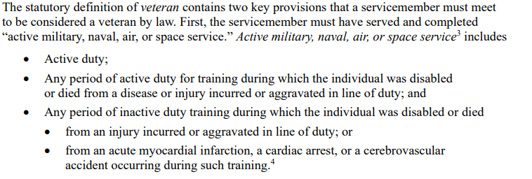
Definitions of a Veteran (Federal)
The U.S. Census defines a veteran as “men and women who have served even for a short time” but are not currently serving on active duty.” (US Census Bureau)
An individual that served 24 months on active duty. (VA.gov)
According to Title 38 of the Code of Federal Regulations, a veteran is defined as anyone who served in the active military, naval, or air service and was discharged or released under conditions other than dishonorable. (VA.gov)
Congress.gov
Notes:
Identify State: Federal: VORP:

Slide 9
Definitions of a Veteran (State)
(12) “Veteran”, except in s. 45.001, means any of the following:
(a) A person who has served on active duty for at least one qualifying term of service under pars. (b) to (d) under honorable conditions in the U.S. armed forces or in forces incorporated as part of the U.S. armed forces during a war period or in a crisis zone.
(b) A person who has served on active duty in the U.S. armed forces or in forces incorporated as part of the U.S. armed forces under honorable conditions, for 2 continuous years or more or for the full period of his or her initial service obligation, whichever is less.
(c) A person who has served on active duty for 90 days or more under honorable conditions in the U.S. armed forces or in forces incorporated as part of the U.S. armed forces during a war period or for any period of service under section 1 of executive order 10957 dated August 10, 1961.
(d) A person whose term of service in the U.S. armed forces or in forces incorporated as part of the U.S. armed forces under honorable conditions entitled him or her to receive the Armed Forces Expeditionary Medal, established by executive order 10977 on December 4, 1961, the Vietnam Service Medal established by executive order 11231 on July 8, 1965, the Navy Expeditionary Medal, the Marine Corps Expeditionary Medal, or an equivalent expeditionary or service medal.
(e) A person who was honorably discharged from the U.S. armed forces or from forces incorporated as part of the U.S. armed forces for a service-connected disability, for a disability subsequently adjudicated to have been service connected, or for reasons of hardship.
(f) A person who was released under honorable conditions from the U.S. armed forces or from forces incorporated as part of the U.S. armed forces due to a reduction in the U.S. armed forces.
(g) A person who died while in service in the U.S. armed forces or in forces incorporated as part of the U.S. armed forces.
(h) A person who, while serving in the U.S. armed forces or in forces incorporated as part of the U.S. armed forces, is missing in action.
(i) A person who died as the result of a service-connected disability.
(j) A person who died in the line of duty while on inactive or active duty for training purposes in the U.S. armed forces, in forces incorporated as part of the U.S. armed forces, or in the national guard.
(k) For purposes of ss. 343.14 and 343.17 only, a person who was admitted into the United States as a refugee from Laos under 8 USC 1157 and served with a special guerilla unit, or irregular forces, operating from a base in Laos in support of the U.S. military during the period beginning February 28, 1961, and ending September 18, 1978. The person shall provide documentation of the person’s service with a special guerilla unit or irregular forces as provided under section 4 of the federal Hmong Veterans’ Naturalization Act of 2000, P.L. 106-207.
Wisconsin legislature, Chapter 45, 12

Slide 10
Definitions of a Veteran (VORP)
Currently serving/have served in the national guard and/or a reserve component of the U.S. armed forces
Served on active duty in any of the U.S. armed forces, forces incorporated as part of the U.S. armed forces
Discharged under conditions other than dishonorable
Bad conduct and uncharacterized discharges accepted
Wisconsin Legislature, Ch.45, 295

Slide 11
Levels of Veteran Services
Local
Veteran service organizations (VFW, American Legion, DAV, etc)
Nonprofits (veteran-specific/community-based)
County & Tribal Veteran Service Offices (CVSOs)
Veteran treatment court
State
Wisconsin Dept of Veterans Affairs
Cemeteries
Veterans Homes
VORP
Grant Per Diem (GPD) Transitional Housing Programs
Education and Employment benefits
Federal
Healthcare/VAMC/CBOC
Compensation & Pension
Housing
MH and/or SUD residential treatment
Etc
Notes:
Cover Veteran benefits Hand out

Slide 12
Current practice: “Are you a veteran?”
Best practice: “Have you served in the military?”
Notes:
How do you ask the right question?
It’s important to change our language around acknowledging someone’s service in the military. Asking ‘are you a veteran?’ can be limiting and negate many prior service members experiences as they may individually not identify as a veteran due to length of service, active duty vs NG/Reserve components, discharge status, etc. Changing our language to be more inclusive to “Have you served in the military?” opens the door to learning more about someone’s service history to connect them to appropriate resources they may be eligible for and validates their service with this country.

Slide 13
Building Partnerships and Connecting Systems
Community Veteran Engagement Boards (CVEBs)
Suicide Prevention Task Forces
County & Tribal Veterans Service Officer Association of Wisconsin - https://wicvso.org/
Veteran Service Organizations
https://edexec.co.uk/building-strong-partnerships-between-schools-and-the-community/
Notes:
Chandler
Connecting Systems – cover community engagement boards, CVSO coalitions, Roundtable Groups, VSOs non for profit orgs
- Important for organizations and groups working for similar causes to work collaboratively so as to bring effective service delivery but also so as to not duplicate services or waste resources.
- Highlight veteran specific partnerships
- Certified Veteran Engagement Boards (CVEB) “The Community Veterans Engagement Board (CVEB) model enables Veterans, Servicemembers, Military Families, Veteran advocates, community service providers, and stakeholders to have a collective voice in identifying their community goals and work to resolve gaps in service at the local level to improve service delivery for Veterans” – Fox Valley Veterans Council and Veteran’s Health Coalition
- Also, Veteran roundtable groups designed and networking, collaborating on resources and events, informing/educating the public on veteran specific topics such as resources, changes to benefits, etc.
- Veteran service organizations such as DAV, American Legion, VFW, Marine Corp League, etc.
- Veteran non for-profit agencies – housing programs, service organizations, service dog, etc.

Slide 14
Veteran Outreach & Recovery Program

Slide 15
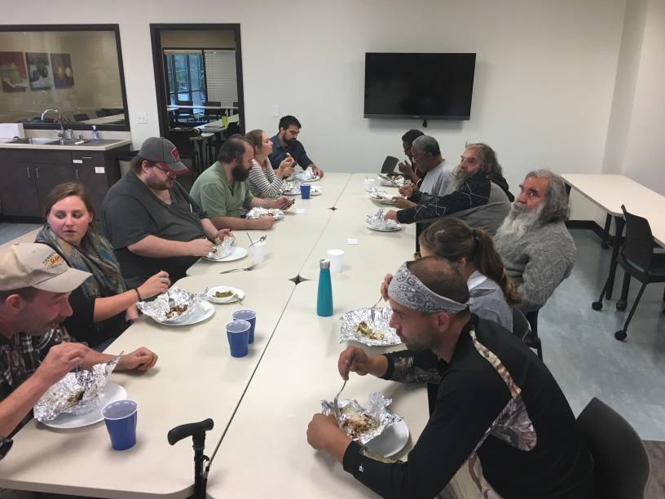
What is VORP?
Pillars of Excellence Award Winner
The Veterans Outreach & Recovery Program is a comprehensive, coordinated outreach program serving veterans who would benefit from connection with community services and who may need support in navigating those service systems with a special focus on treatment and recovery support.
Notes:
VORP received national recognition and was awarded the Abraham Lincoln Pillars of Excellence Award in 2020 for being one of the outstanding programs that support veterans across the nation

Slide 16
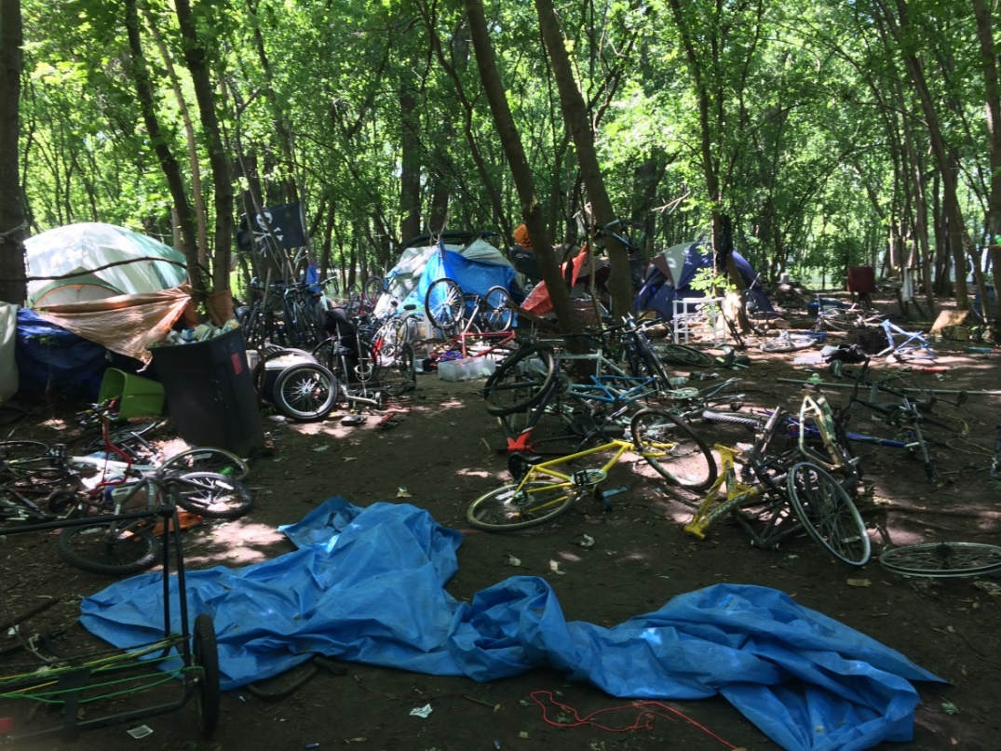
History
Grant Collaboration with DHS
2014 – 2017
49 Counties
Strict eligibility
State Pilot
2018 – 2019
72 Counties
Referral & Recovery Tracks
Permanent Funding
July 2019; 11 regions
Recovery Track
ARPA Expansion (ends 6/30/25)
5 additional regions; total of 16 regions
Notes:
During the Grant – 330 Enrollees and over 800 Contacts

Slide 17
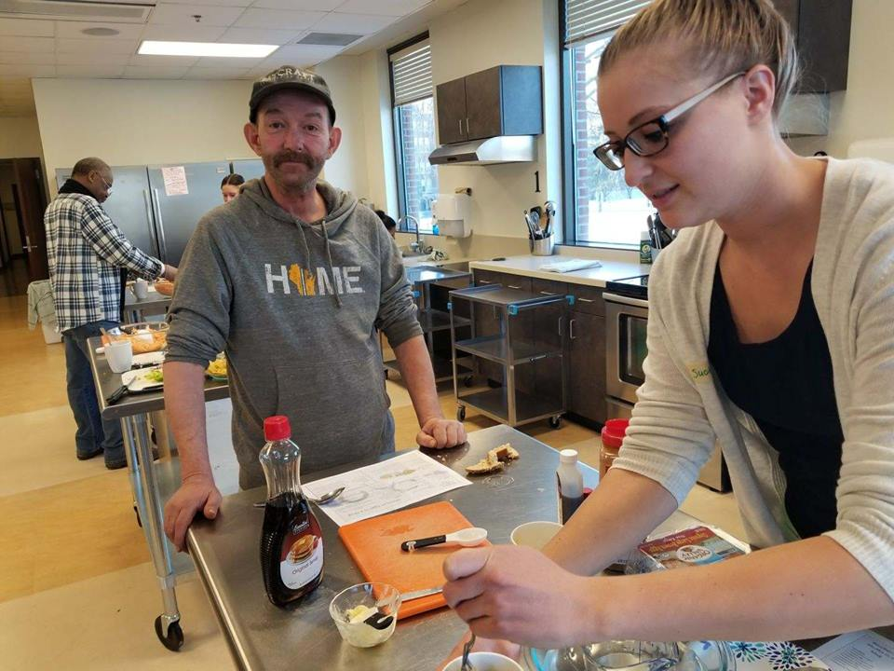
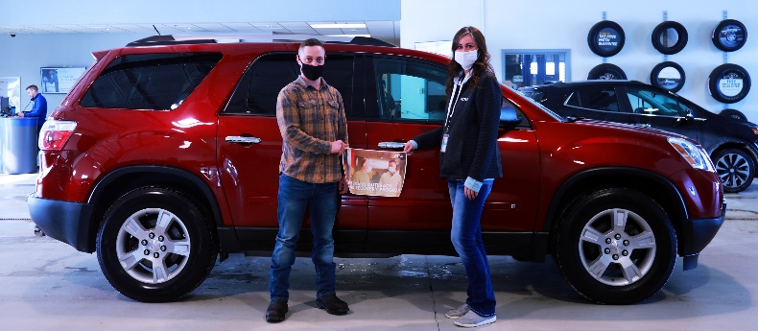
VORP Today
Permanent funding through State of Wisconsin
No requirement of homelessness or diagnosis
Provide case management
Serve veterans who are in crisis
Serve all 72 counties, in 16 Regions, with 16 outreach staff and 3 clinical coordinators

Slide 18
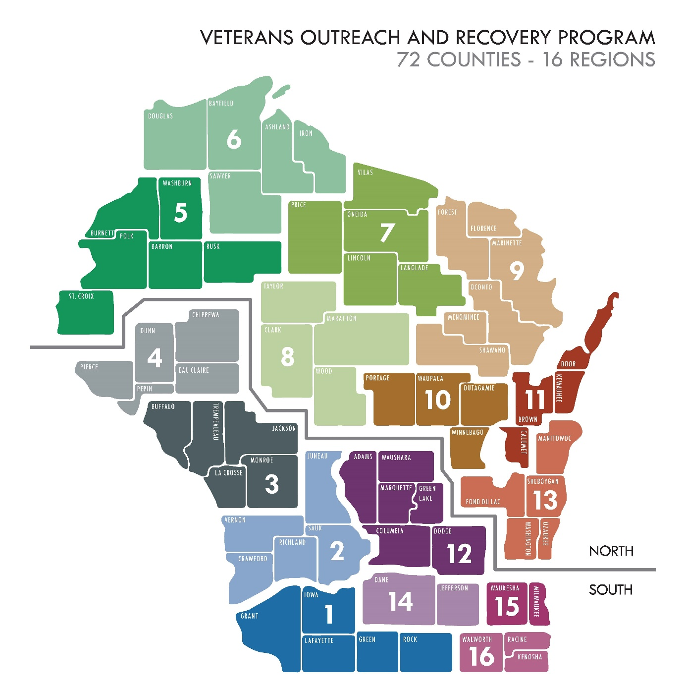

Slide 19
Criteria for Enrollment in VORP
Verification of the following:
Are serving in the national guard of WI or a reserve component of the U.S. armed forces
Served on active duty in the U.S. armed forces, forces incorporated as part of the U.S. armed forces, a reserve component of the U.S. armed forces, or the national guard of any state and were discharged under conditions other than dishonorable
Notes:
Service in the military does not guarantee USDVA benefits or healthcare.
VORP serves those who do not meet eligibility for other veteran programming.

Slide 20
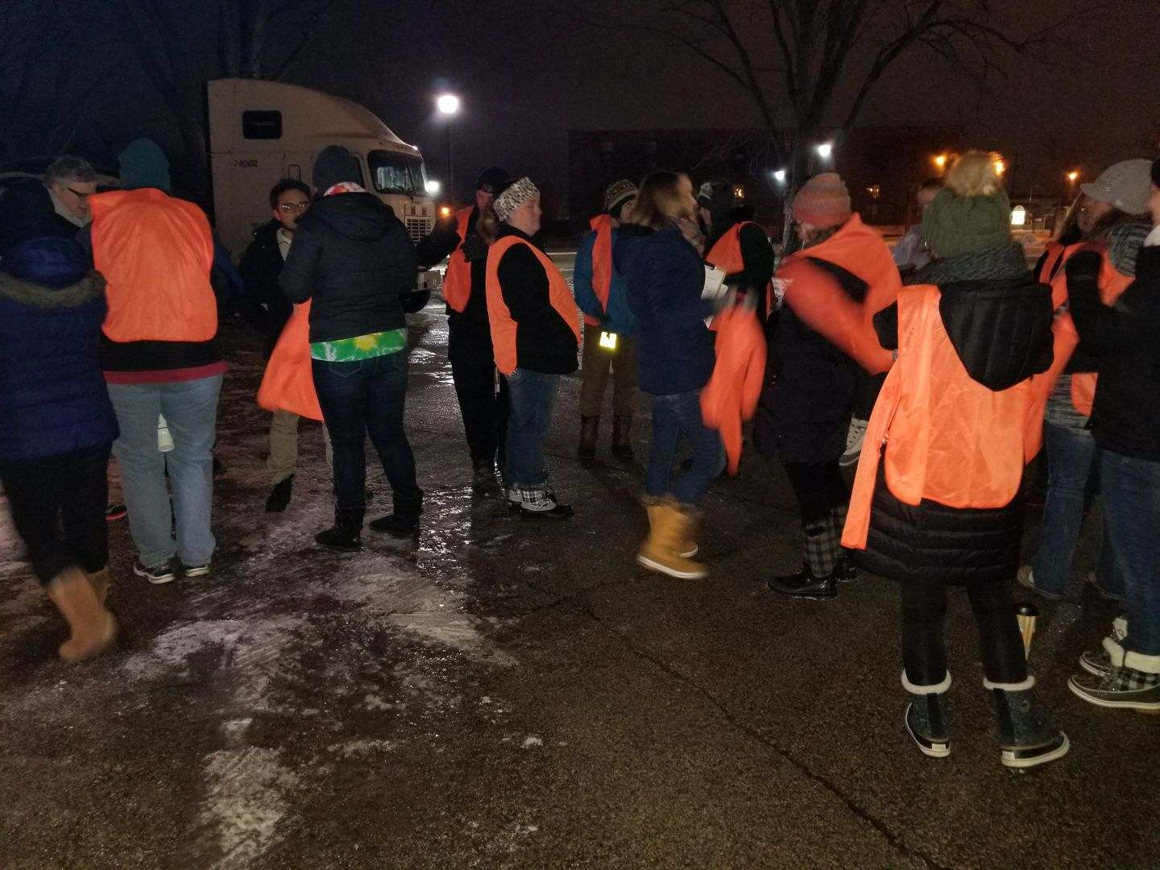
Where We Serve Veterans
Taking our programs and services to the Veteran. Into the family home, on the street, in the jails, in the parks, treatment facilities, homeless shelters, and even in a disabled or roadside parked car.

Slide 21
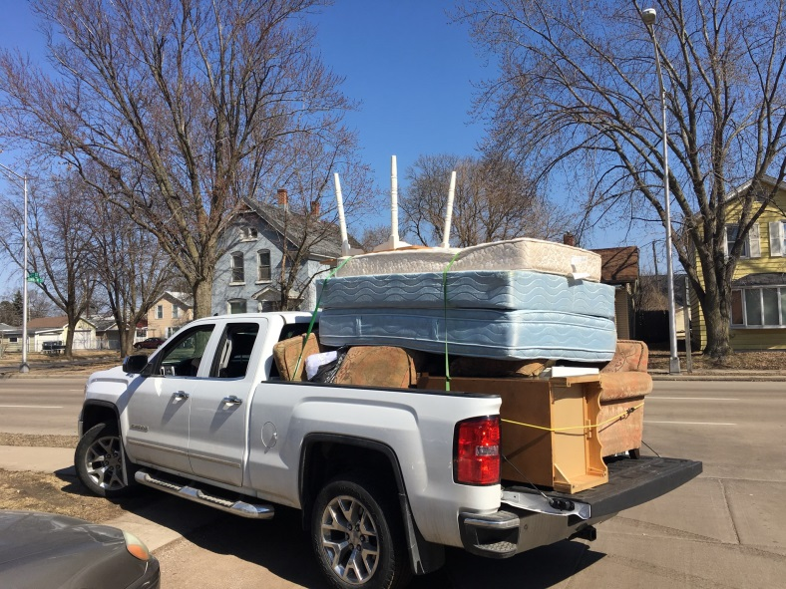
Services
Home – Assistance in having a stable, safe place to live
Motivation – Assistance finding the internal motivation needed to change behavior
Recovery – Assistance with mental health and/or substance use issues
Payment of treatment for mental health and/or substance use disorders
Notes:
WDVA payment only as a last resort when USDVA, county, and other care benefits are unavailable.

Slide 22
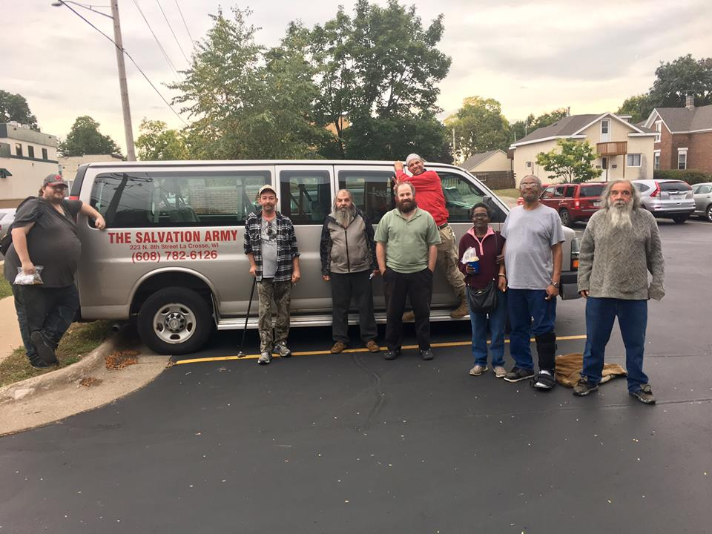
Services
Health – Assistance in managing conditions and making choices that support well-being
Purpose – Assistance in conducting meaningful daily activities for the independence, income, and resources to participate in society
Community – Assistance in building relationships and social networks

Slide 23
Program Connection
VORP to VHRP | VHRP to VORP
Conduct outreach for each others' programs
Make referrals to one another
Resource sharing
Transportation into/out of program (only if enrolled in VORP prior to program entry) | Involve in discharge planning
On site support and connection | Staffing cases
Location assistance if AWOL

Slide 24
Unmet Community Needs and Barriers Experienced by Veterans
Transportation
Accessible and equitable community resources (i.e. rural vs. urban Wisconsin services)
Affordable housing (i.e. eviction history/credit scores, limited low-income housing (waitlists), criminal backgrounds)
Landlord participation in housing programs
Female/Family transitional housing options throughout the state
Program discharge planning and program release planning (i.e. treatment facilities, prisons, hospitals)
Wait times/lists for SUD and MH programs (i.e 3+wk wait times)
Pets/ESAs
Notes:
Affordable housing
Rapid re-housing
Motel vouchers
Rent reasonableness

Slide 25
Homelessness and Suicide
Shared risk factors increase risk for suicide: substance use, mental illness, adverse childhood experiences, social isolation, and unemployment
Twice as likely as non-Veterans who have experienced homelessness to report lifetime suicide attempts
Nearly four times as likely as other Veterans to have ever attempted suicide
Veterans with past-year housing instability six times as likely as those who did not experience housing instability to report suicidal ideation
Veterans who experienced homelessness more likely than male counterparts to have suicidal thoughts or attempted suicide, although male veterans more likely to complete suicide
Notes:
While the Veteran homeless population has decreased by nearly half over the last decade (from an estimated 73,367 in 2009 to 37,878 in 2018), homelessness remains a significant problem.
Approximately 18 out of every 10,000 Veterans experienced homelessness on a single night in 2018.
Homelessness and suicide share several of the same risk factors (including substance use, mental illness, adverse childhood experiences, social isolation, and unemployment) which is why Veterans who have ever experienced homelessness are at increased risk for suicidal ideation, suicide attempts, and suicide death.
Veterans who have experienced homelessness are almost twice as likely as non-Veterans who have experienced homelessness and 11 times as likely as other Veterans to report lifetime suicide attempts.
Even after controlling for other risk factors, Veterans who have experienced homelessness in their lifetime are nearly four times as likely as other Veterans to have ever attempted suicide.
Housing instability (measured as concern over being able to pay rent or a mortgage) is also associated with suicide. In one study, Veterans with past-year housing instability were six times as likely as those who did not experience housing instability to report suicidal ideation.
More male Veterans than female Veterans are homeless, but female Veterans may be at greater risk for homelessness. Female Veterans who have experienced homelessness in their lifetime are also more likely than their male counterparts to have had suicidal thoughts or attempted suicide, although male veterans are more likely to complete suicide. And female Veterans who had suicidal thoughts or attempted suicide were more likely than their male counterparts to have experienced childhood and current sexual and physical abuse.

Slide 26
Ask QPR is intended to offer hope through positive action, this is not intended to be a form of counseling or treatment
​To find out more information contact Cal Stammer at 608-733-1791 or email:
calvin2.stammer@dva.wisconsin.gov​​

Slide 27
QPR
Training lasts about an hour and a half
VORP staff will provide the training free of cost
Cal Stammer and VORP staff will work with interested party to schedule the training
Materials will be provided by VORP staff
VORP Clinical Coordinator will be on site
We have seen people get triggered during the training
Participants will receive a 1-hour QPR Certificate
Projector and speaker can be provided by VORP staff
We would like to use the technology at the local agencies if they are on site

Slide 28
FY24 QPR Trainings Completed Examples
La Crosse Warming Shelter
La Crosse Independent Living Resource
American Legion Post 487-Cable, WI
Grace Evangelical Lutheran Church
Stoughton VFW
Oshkosh CORP
Fox Valley Veterans Council
Manitowoc Police Station
Phillips VFW
WDVA Claims & VBRC teams
WEHR Nature Center-Franklin, WI

Slide 29
Harm Reduction/Lethal Means Safety
https://www.mirecc.va.gov/visn19/lethalmeanssafety/
Notes:
Chandler
Highlight statistic of number of veteran suicide by firearm (71%) (QPR,2022)

Slide 30
Gunshop Program
Live Today-Put It Away - Captain John D Mason Veteran Peer Outreach Program
Introduction to Wisconsin's Gun Shop Project and Safe Storage Program | The Captain John D. Mason Program, on behalf of the Southeastern Wisconsin Suicide Prevention Taskforce and BeThereWis, is working to promote Wisconsin's... | By Captain John D. Mason Veteran Peer Outreach Program | Facebook
47 Gun Shops and Ranges have signed up since the start of the Gun Shop Program
The firearm facilities noted on this map in PURPLE are voluntarily providing storage of firearms outside of your home as a way to help prevent suicide.
8 Law enforcement agencies
The following police/sheriff departments noted on the map in BLUE are part of Voluntary Firearm Safekeeping Program and voluntarily provide this service to the community. Be sure that you have the firearm(s) unloaded when you take them in. See below the map for additional information for each Law Enforcement Location.
Questions or more information please reach
TaskForce@betherewis.com

Slide 31
Questions? Visit WisVets.com to learn more >>
VORP Contact Information: Calvin W Stammer Program Supervisor
Calvin.stammer@dva.wi.gov
THANK YOU
Connect with us on Social Media!
Facebook.com/WisVets
Instagram.com/WisVets

