Slide 1
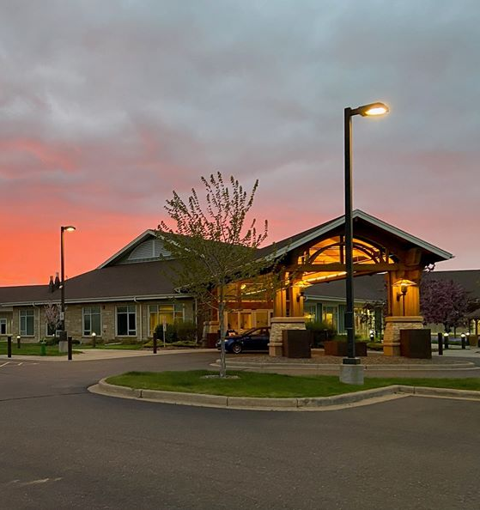
Agency Overview
WACRO - 2025 Military Connected Services Conference

Slide 2
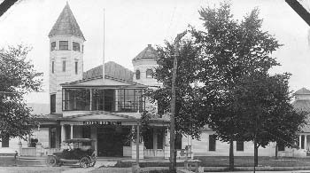
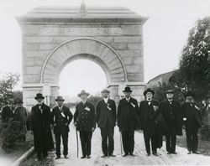
History of WDVA
Wisconsin Department of Veterans Affairs
Created in 1945
Consolidated veterans’ programs under one agency
Provides grants and a variety of services to eligible Wisconsin veterans and their families.
2011 Wisconsin Act 36 Changes
Composition of the Board of Veterans Affairs
Appointment of WDVA Secretary
Supervision of the Department

Slide 3
Board on Veterans Affairs
Administrative Rule consultation
Required review of draft rules
Discretionary report of comments and opinion, but if provided shall be included in required report of proposed rule to Legislature
Receive advice from our other advisory body – the Council on Veterans Programs
Solutions and policy alternatives
Veterans Memorials
Camp Randall Memorial Park
Grant evaluations
Notes:
Per s. 15.01 (1r), Stats., Board means a part-time body functioning as the policy-making unit for a department or independent agency or a part-time body with policy-making or quasi-judicial powers.
Authority is NOT related to operations or administration of the department’s activities or programs.
s. 45.03 (3) (a) The COVP shall advise the board and the department on solutions and policy alternatives relating to the problems of veterans.
MEMORIALS s. 45.70 (1b) Board may approve, recommend, and veto any proposed plans, modifications, and changes or policies with respect to established state memorials and any future veterans state memorials, and may recommend the creation and establishment of future veterans state memorials. But Board may only take any of the aforementioned actions if cost is estimated to exceed $25,000.
CAMP RANDALL s. 45.70 (2), the following may not be placed or erected upon Camp Randall Memorial Park:
Structures other than memorials approved by the board
Walks, roads, or subterranean footings
The only exception to the above is if it is authorized by the Legislature.
GRANT EVALUATIONS The current rules, sections VA 2.07 and 2.08, require at least one member of the board to participate in the evaluation of applications for the nonprofit and entrepreneur grants. Chapter VA 2 is currently open to amend that requirement from “shall” to “may” include a member of the board on the evaluation committee.

Slide 4
Council on Veterans Programs
The COVP advises the Board of Veterans Affairs (BOVA) and the Department on solutions and policy alternatives relating to the problems of veterans.
Biennial Report:
The COVP and Department jointly or separately shall submit a report regarding the Council to the Chief Clerk of each House of the Legislature for distribution to the Legislature by September 30 of each odd numbered year.
The report shall include a general summary of the activities and membership over the past 2 years and each organization on the council.

Slide 5
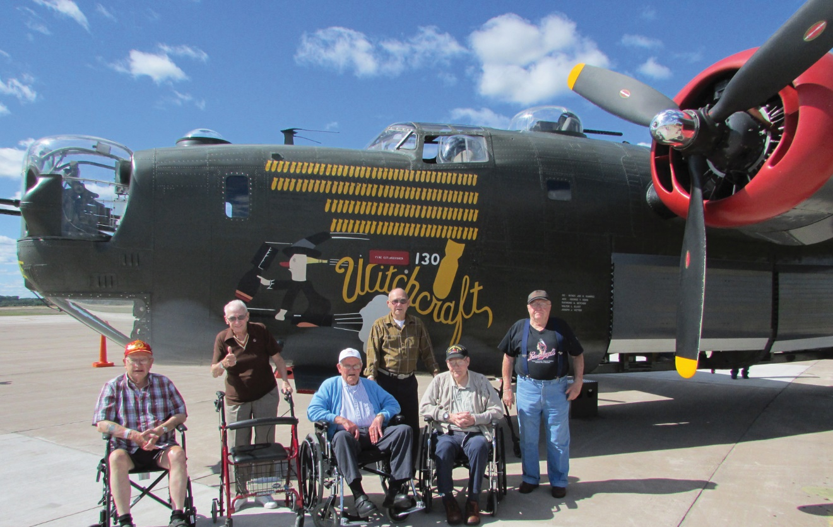
The mission of the Wisconsin Department of Veterans Affairs is to work on behalf of Wisconsin's veterans community — veterans, their families and their survivors — in recognition of their service and sacrifice to our state and nation.​​​

Slide 6
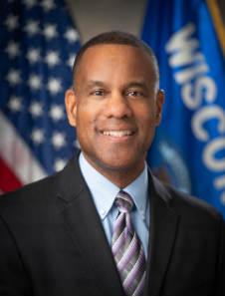
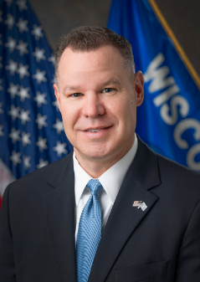
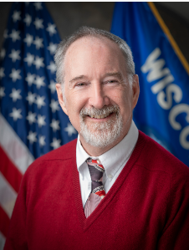
Office of the Secretary - Executive Leadership Team
James Bond
Secretary-designee
Chief Executive Officer
Chris McElgunn
Deputy Secretary
Chief of Operations
Joey Hoey
Asst. Deputy Secretary
Chief Legislative Liaison
The Secretary is responsible for the leadership and management of WDVA, including strategic and long-range planning initiatives that will align with the Department's vision.
The Deputy Secretary is responsible for day-to-day operations, as well as directing and coordinating the Department's strategic planning and program development.
The Assistant Deputy Secretary is the primary contact for inter-governmental agency functions and is the Department's legislative liaison.

Slide 7
WDVA Agency Info
Biennial budget: $290,175,700
Homes: 84%
Aids to Veterans: 12%
Cemeteries: 2%
Museum: 3%
819 Total Employees
Veteran Homes – 629
Veteran Benefits – 46
Cemeteries & Memorial Services – 40
Museum – 26
Office of the Secretary – 17
Enterprise Services - 61

Slide 8
Division of Veterans Benefits
DVB administers an array of grants, benefits, programs, and services to all eligible state veterans, their families, and to organizations that serve veterans.
Bureau of Programs and Services
Bureau of Health Services
Bureau of Cemeteries and Memorial Services

Slide 9
Bureau of Veteran Programs and Services
Grants to Organizations
VSO service grants
CVSO and TVSOs
Transportation grants – DAV and counties
Non-Profits that assist veterans and families
Non-Profits that assist veteran entrepreneurs and improve hiring of veterans
Employers who hire disabled veterans
Grants to Individuals
Wisconsin GI Bill
Veterans Assistance Grants
Subsistence Aid
Health Care Aid
Retraining grant

Slide 10
Programs and Services (cont’d)
Veterans Benefits Resource Center (VBRC)
Veteran engagement and referral: call, chat, email
Veterans’ Eligibility & Application Portal - MyWisVets.com
Federal Claims Assistance
Milwaukee VARO
Initial and appellate
Comprehensive training for
external service officers
Education – State Approving Agency

Slide 11
Bureau of Veteran Health Services
Veterans Outreach and Recovery Program (VORP)
Mental health care and crisis coordination and referral
Local and regional partners
Currently, 16 geographic regions, 5 are temporary through July 1, 2025 (ARPA Funds)
Prior and current reserve component eligible, including OTH
Veterans Housing and Recovery Program (VHRP)
Housing for at-risk veterans
Three locations: Chippewa Falls, Union Grove, Green Bay
Veteran-only; male and female

Slide 12
Bureau of Cemeteries and Memorial Services
Veterans Memorial Cemeteries (Chapter VA 14)
National Cemetery Administration (USDVA)
Southern Wisconsin – Union Grove
4th busiest nationally
Annual interment FY 2022: 1,092
Central Wisconsin – King
Oldest WVMC
Annual interment FY 2022: 199
Northern Wisconsin – Spooner
Newest WVMC
Annual interment FY 2022: 296
Military Funeral Honors (Chapter VA 17)
Coordinates administration of honors around the state
On-site at SWVMC
Engagement: VSO, CVSO, funeral director, active and reserve component

Slide 13
Division of Veterans Homes
Oversees the Wisconsin Veterans Homes:
Skilled nursing homes (Chapter VA 6)
Grand-fathered eligibility
Licensed by Wis. Department of Health Services
Regulated and inspected
U.S. Department of Veterans Affairs
CMS (via DHS)
Three campuses
King
Union Grove
Chippewa Falls

Slide 14
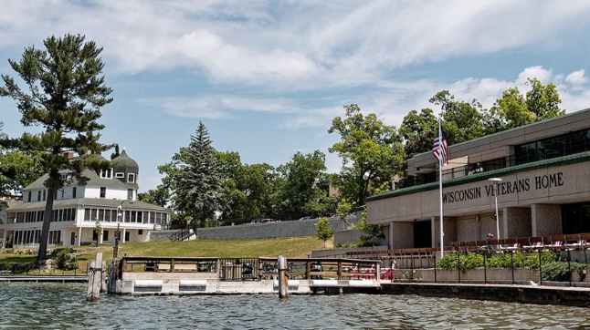
Veterans Home – King
Central Wisconsin 42-acre campus, Waupaca County, On shore of Rainbow Lake (Chain O’ Lakes)
Serving veterans for over 130 years.
521-bed skill nursing facility
Current Census: 296
Marden Center (Activity Center)
Bar & Game Room
Bowling alley
Café
Library
King Exchange (KX)
Museum
Theater
Linked by an underground tunnel system

Slide 15
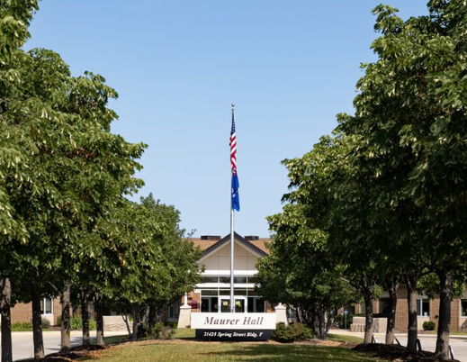
Veterans Home – Union Grove
Southern Center campus; Racine County
158-bed skilled nursing facility
Current Census: 68
30 minutes from downtown Milwaukee
Member Center
Pub
Ceramics studio
Woodworking studio
Library
Chapel

Slide 16
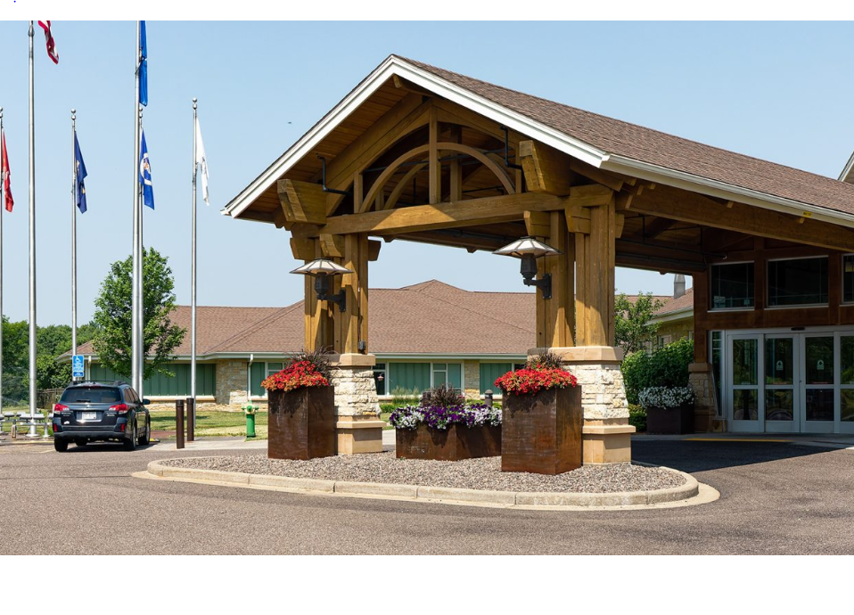
Veterans Home – Chippewa Falls
Adjacent to Northern Wisconsin Center; Chippewa County
72-bed skilled nursing facility
Census: 71
Operated under a Public/private partnership between WDVA and Health Dimensions Group
Features:
Chapel
Beauty/barber shop
Bistro
Library
Community room
Designed in neighborhood style

Slide 17
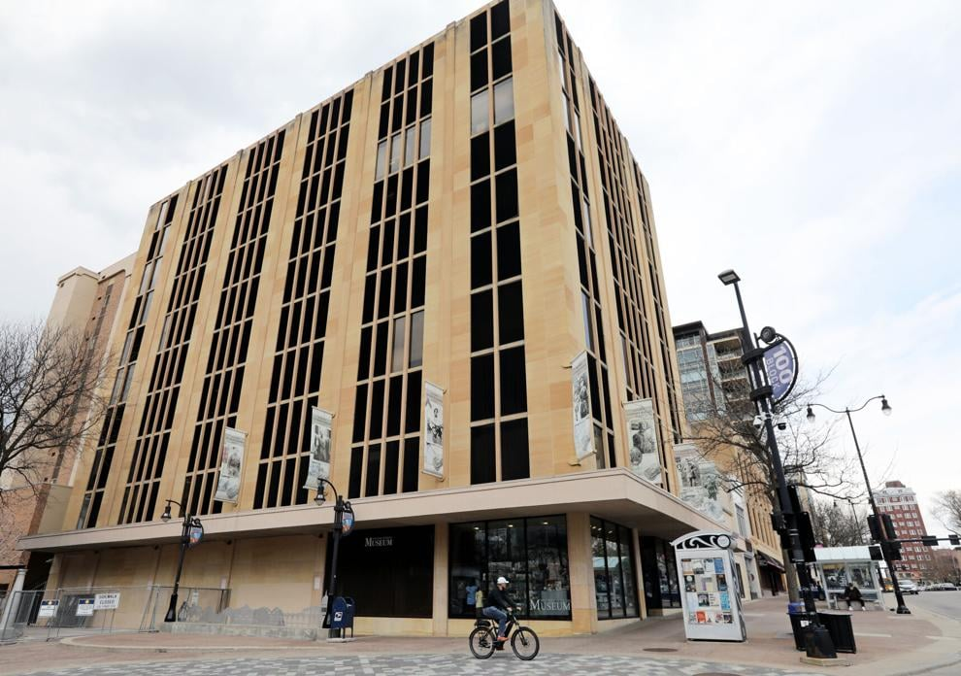
Wisconsin Veterans Museum
Mission: To acknowledge, commemorate, and affirm the role of Wisconsin veterans
in the United States of America's military past and present.
Established by WI Union veterans in the late 19th Century to tell the Civil War Story. Located in the GAR room on the fourth floor of the Capital until 1993 then moved to 30 W Mifflin Street across the Square
An educational activity of WDVA.
Award-winning exhibits and programs (3% on display).
2023-2025 Budget included $9 million dollar appropriation to purchase the building and lot in anticipation of building a new state of the art facility at that location.

Slide 18
WDVA Locations

Slide 19
Certification of Eligibility
WDVA provides certification of eligibility for multiple benefits, many of which are administered by other State Agencies
Veterans and Surviving Spouses Property Tax Credit
WI Department of Revenue
Professional/Occupational Licensure Fee Waiver
WI Department of Safety & Professional Services
Driver License – Veteran Identifier
WI Department of Transportation
Veteran-Owned Farm logo
WI Department of Agriculture and Consumer Protection
Veteran Owned Business logo
Service-Disabled Veteran-Owned Business Preference
WI Supplier Diversity Program
Free & Reduced State Parks Pass For Disabled Veterans
Wisconsin Department of Natural Resources

