Slide 1
VA Debt Management Center (DMC)
School Certifying Official Training
Updated May 2025

Slide 2
Agenda
DMC overview
Digital GI Bill (DGIB) Transition Updates
Debt establishment
Understand collection processes
Debt resolution options
Risks of non-payment
Questions

Slide 3
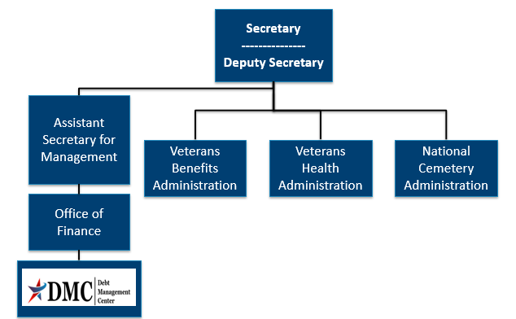
Organization Chart

Slide 4
DMC Mission
Provide distinctive, high quality accounts receivable services through a compassionate and value-added approach, empowering our stakeholders to focus on core missions.

Slide 5
DGIB Updates: DMC Processes
Chapter 33 Modernization Upgrades
Separate debt balances for each term per facility per student in VA system
DMC uses additional deduction codes other than 75
Deduction code is needed for pay.va.gov payments or if check is mailed without remittance from DMC letter
Certain tuition and fees and Yellow Ribbon debts are recouped from subsequent, congruent (there is at least one day of overlap) payments for the same student

Slide 6
DGIB Updates: Pending Issues
Many issues have been resolved
Some letters cannot be issued yet
Some debt fixes are pending- suspended debts will still appear on debt lists but are not being collected

Slide 7
DGIB Updates: DMC Processes
Non Chapter 33 Modernization Upgrades
Chapter 35, 30, and 1606 debts for students will be transitioned to a new payment processing system by the end of the summer

Slide 8
Debt Establishment
SCO Certifies Student
Regional Processing Office (RPO) Processes Certifications
DMC Collects Debts
Sends collection letters for debts
Sends a letter when payments are issued or debt created
Processes collection actions
Evaluates entitlement
Issues payments and establishes debts
Communicates with student about certification process

Slide 9
Debt Establishment
Post 9/11 GI Bill Benefits
Tuition/Fees/Yellow Ribbon
School Debt
Books and Supplies
Student Debt
Housing Stipend/ Kicker
Student debt

Slide 10
Debt Establishment Reasons
Student never attended any classes (All T/F/YR)
Payment for wrong student or duplicate payment
(Erroneous amount)
Reporting reduced T/F/YR amount, no change to training
(Amount of $ change )
Payment above certified amount due to VA data entry error
(Erroneous amount)
Student dropped/added a course, no net change in training time
(Amount of $ change )
Student completely withdrew on or before first day of term
(All T/F/YR)
Notes:
.

Slide 11
Debt Establishment Reasons
Student withdrew after first day of term
Student reduced hours before or during term
School reported reduction in T/F/YR due to student reducing or terminating training

Slide 12
Debt Establishment Reasons
Action | Condition | Will Be Effective
Reduction | During Drop Period | End of month the reduction occurred
Termination | During Drop Period | Actual date of withdrawal
Reduction | Punitive Grade assigned | End of month the reduction occurred
Termination | Punitive Grade assigned | Actual date of withdrawal
Reduction or Termination | Non- Punitive grade assigned | First day of the Term
Reduction | Non- Punitive grade AND Mitigating Circumstances (MITCs) | End of month the reduction occurred
Termination | Non- Punitive grade AND Mitigating Circumstances (MITCs) | Actual date of withdrawal

Slide 13
School Debt Example
SCO certifies term 08/28/2024 – 12/16/2024, T&F $10,000.00 (for credits)
VA pays $10,000.00 for the 08/28/2024 – 12/16/2024 term
School reported a change to tuition and fees with no change to credits, the new tuition and fees reported was $5000
Student then reduced training effective November 15th with punitive grades and new tuition and fees amount is $2500
How would you calculate this debt?

Slide 14
School Debt Example continued
School Debt Calculation
Amount due for term is $4633.03
($5000/109 days in the term x 93 days attended at this rate= $4266.06) plus
($2500/109 days in the term x 16 days attended at this rate =$366.97)
$10,000 paid - $4633.03 due = Debt of $5366.97

Slide 15
Preventing School Debts
Educate students about impact:
Reducing Training
Changing class schedule
When
non-punitive
grades occur
School can include mitigating circumstances on certification
Student can submit mitigating circumstances to RPO
Certify $0 tuition/fees before term begins
Allows student to receive books and housing on time
Non-punitive grades
Certify T/F/YR amount at a later date

Slide 16
School Debt Collection Process
DMC sends Notice of Indebtedness letters, monitors accounts, and advises debtor of any delinquency, including the requirement to refer their account to Treasury
If DMC receives payment,
next collection letter is deferred
DMC Sends 1st Letter
30 days
DMC Sends 2nd Letter
30 days
DMC Sends 3rd Letter
60 days
Debt Referred to Treasury (120 days)

Slide 17
School Options
School Options
Pay in Full
Dispute
Compromise
Payment Plan

Slide 18
How to Pay a Debt
Pay by check: mail the check, payment coupon(s) and/or letter to:
VA Debt Management Center
Bishop Henry Whipple Federal Building
P.O. Box 11930
St. Paul, MN 55111-0930
Recommend no more than 25 students per check
Pay online: www.pay.va.gov
Check SCO handbook for other options

Slide 19
How to Pay a Debt on www.pay.va.gov
Payee and Person entitled name format are on DMC school debt letters
Payee is not always 00, please verify payee on DMC letter
Deduction Code is not always 75, please verify on DMC letter

Slide 20
Ask VA (AVA) for School Inquiries
All school inquiries and disputes should be submitted using AVA (https://ask.va.gov/)
Select “Debt for benefit overpayments and health care copay bills” as the category and “Education benefit overpayments (for schools)” as the topic
Under “My inquiry is” select “On behalf of a Veteran”- this enables you to select School Certifying Official or Other (Business) under relationship to Veteran
You must sign in to AVA to select the category “Debt for benefit overpayments and health care copay bills”

Slide 21
Requesting a debt list in AVA
DMC can provide debt lists by facility code upon request
Since the debt list is not associated with one specific Veteran, you can choose general question to submit your debt list by facility code request
If you have multiple facilities, list the additional facility codes in the “What is your Question?” box

Slide 22
DMC School Official Debt Line
833-720-2574 (international 612-843-6508)
Use for questions on Post 9/11 GI Bill Tuition and Fees debts such as:
Term dates for a debt
Confirm a payment was received
Confirm an outstanding balance
Assistance with an online payment
Disputes must be in writing. Submit via https://ask.va.gov/ (Select category: “Debt for benefit overpayments and health care copay bills” and topic: “Education benefit overpayments (for schools)”

Slide 23
Student Options
Student Options
Pay in Full
Dispute
Payment Plan
Waiver
Reduced Benefit Offset
Compromise
Temporary Suspension

Slide 24
VA Debt Portal for Veterans
Debt Portal: https://www.va.gov/manage-va-debt/
Veterans can log in to view balances
FAQ’s
Email notifications to Veterans
Online VA Form 5655 Financial Status Report (FSR)
One VA Digital Debt Letter

Slide 25
Treasury Overview Debt Collection Tools
Treasury has two main programs for student and school debt collection
Treasury Offset Program (TOP)
Cross-Servicing (CS)
Federal grants
Social Security
Civilian pay
Military retirement
Private Collections Agencies (PCA)
Telephone collections
Administrative Wage Garnishment (AWG)

Slide 26
Become a Debt Superstar (Contact DMC)
https://ask.va.gov | Online inquiry system (category: Debt for benefit overpayments and health care copay bills, topic: Education benefit overpayments (for school officials)
https://www.va.gov/manage-va-debt/ | Veteran Debt Portal
833-720-2574 | DMC School Official Debt Line
800-827-0648 | DMC Toll Free Line - Students

Slide 27
Issue Not Getting Resolved
Julie Lawrence – Chief Education and External Relations
Julie.Lawrence@va.gov
Nicole Haselberger – Assistant Chief Education and External Relations
Nicole.Haselberger@va.gov
Tami Dorle – Supervisory Financial Administrative Specialist
Tamara.Dorle@va.gov
Gary Greenwood – Management Analyst
Gary.Greenwood2@va.gov

Slide 28
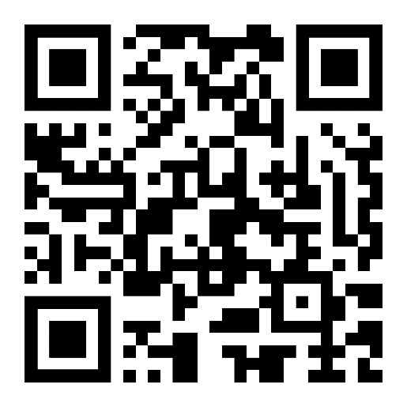
DMC Presentation Survey
DMC values your time and feedback on our presentation. We would appreciate it if you’re able to complete the survey below.
https://www.surveymonkey.com/r/DMCSCO

Slide 29
Backup

Slide 30
Deduction Codes for School Debts
Found on the top right of DMC letter
Can be any of the following:
75, 63, 91, 92, 93, 94, 95, 96, 97, 98
Please also remember to verify the payee for online payments (not always 00)

Slide 31
Example of Congruent Offset
Congruent Payment Recoupment Example
SCO certifies term 09/01/2024 – 12/15/2024,12 in-residence credits, T&F $10,000.00
VA pays $10,000.00 for the 09/01/2024 – 12/15/2024 term
Student drops prior to the start of the term creating debt of $10,000.00
Same student is certified for the mini-term of 10/01/2024 – 11/15/2024 for 6 in-residence credits with a tuition and fees of $5,000.00.
VA will not release any T&F payment and will reduce the outstanding T&F debt by $5,000.00
If facility has already submitted a repayment of $10,000.00 to the Debt Management Center (DMC), VA will send $5,000.00 to the facility

Slide 32
Debt Establishment: Compliance Survey
Debt | Collection | Source | Dispute
School Debt | DMC collects | Tuition/Fees/Yellow Ribbon | Dispute with DMC
Student Debt | DMC collects | Books/Supplies Housing/Kicker | Dispute with DMC
Potential School Liability | RPO collects (no DMC involvement) | School may have to repay Books/Supplies/ Housing/Kicker on behalf of students | Special process (no DMC involvement)

Slide 33
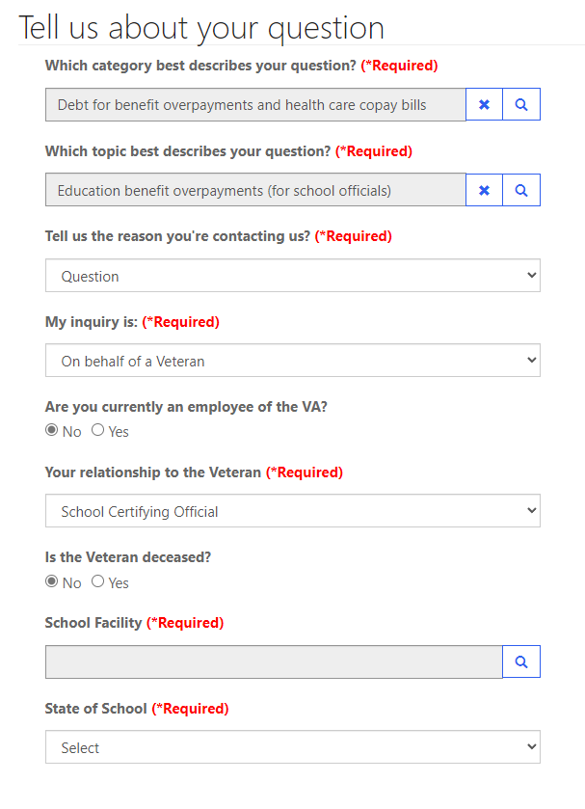
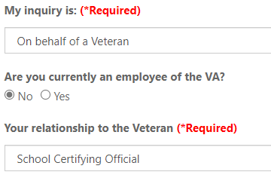
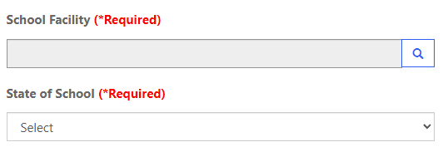
AVA for School Inquiries

Slide 34
Tips for School Inquiries
When submitting disputes and inquiries via AVA, please include:
One inquiry per student
Identifying information for the student
School name and facility code
Debt amount
Supporting details (front and back of cashed check, when was updated certification sent, etc.)

Slide 35
How to Contact TOP
Schools may contact TOP by calling the TOP Call Center:
1-800-304-3107
To provide you with information about an offset, Treasury will need to know:
The caller’s name, department and job title. The job title will need to indicate a need-to-know position
At least one of the following:
date of the payment
amount of the original payment
amount of the offset
Make sure to obtain the Debt Account ID related to the offset from Treasury (typically ends in 0075 for school tuition) before contacting DMC about an offset

Slide 36
When to Contact TOP vs. DMC
Information Treasury Has
Debt Account ID number for a given offset (can look up debt account ID with offset info)
Entity that referred a debt that was offset
Information about payment that was offset
Information DMC Has
Details about debt we referred (need Debt account ID from Treasury to identify debt)
Student associated with referred debt
Term dates for referred debt

Slide 37
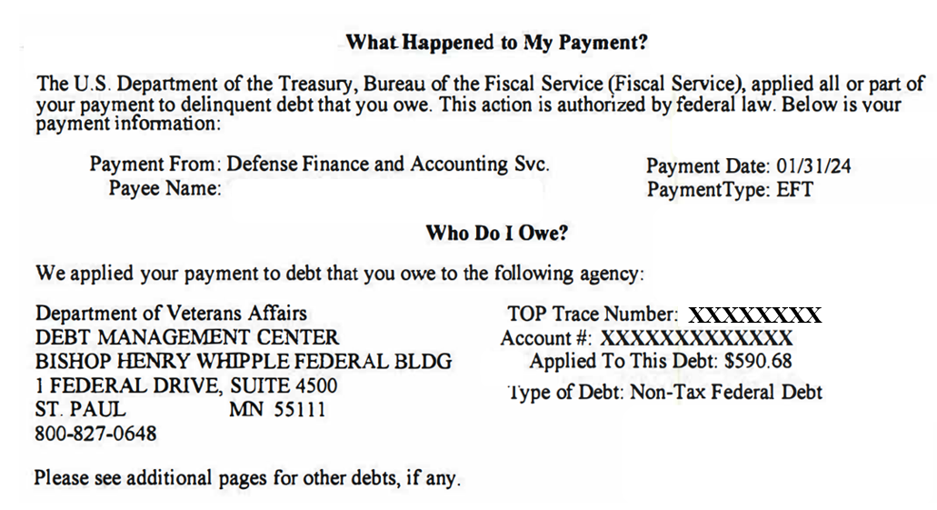
TOP Letter Example

Slide 38
Federal Debt Collection Laws
The Debt Collection Act of 1982
Authority for collection by administrative offset
The Debt Collection Improvement Act (DCIA) of 1996
Agencies required to refer delinquent non-tax debts to the Department of Treasury at 180 days
Digital Accountability and Transparency Act (DATA) of 2014
Changed referral requirement for delinquent non-tax debts from 180 days to 120 days

Slide 39
How to Self-Certify
Click on the URL or copy and paste it in your web browser. https://vba-tpss.vbatraining.org/assess/trkSignIn?refid=XSCO
Enter your email address and eight (8) digit facility code and click Next
(If you do not have a user profile, click New User Account and follow the steps to set up your profile.)
Scroll down and click the Conference/Workshop/Virtual Training tab
Select the applicable training session from the list of topics that appears on the right side of the screen by clicking Begin
To enter Conference/Workshop/Virtual Training Title: Click the dropdown arrow and select SCO Virtual Training Session and click Submit
Enter the start date and the end date
Enter your Facility Name, City and State (Main Campus) and click Submit
Certify your attendance by clicking Agree and then submit.
Print your training certificate and keep for your records

