Slide 1

U.S. Department of Veterans Affairs
Work Study Allowance Program
Pre-Decisional

Slide 2
Disclaimer
The information in this presentation should be considered talking points for discussion and information sharing. More comprehensive information may be available through other VA resources. Information in this presentation was current and correct on the date given.
Notes:
Before we begin, please remember the information in this presentation should be considered talking points for discussion and information sharing. More comprehensive information may be available through other VA resources. Information in this presentation was current and correct on the date given.

Slide 3

Introduction
Work Study
A Veterans Administration (VA) tax exempt education benefit paid to students for performing VA-related activities at an approved Work Study site.
Notes:
Work Study is a Veterans Administration (VA) tax exempt education benefit paid by VA to students for performing VA-related activities at an approved Work Study work site. The money a student receives for this benefit is not considered income and there is no cost to the approved Work Study site.
This course is designed for new School Certifying Officials interested in learning what the VA Work Study program has to offer. This session will cover the basics of Work Study including what qualifies a student and work site for Work Study, how Work Study contracts are written, and the payment procedures.

Slide 4
Learning Objectives
Know work site and site supervisor responsibilities
Identify the criteria used to select students
Understand Work Study contracts
Identify the requirements for payments
Understand how to supervise students
Know how to contact Work Study
Notes:
Upon completion of this training, you should be able to:
*Know work site and site supervisor responsibilities
Identify the criteria used to select students
Understand Work Study contracts
Identify the requirements for payments
Understand how to supervise students
Know how to contact Work Study

Slide 5
Work Site Qualifications
Approved Work Sites
Work Assignments/Duties
Site Supervisors
Notes:
The next series of slides will help you understand which facilities are considered approved work sites, the different types of work assignments or job duties students can perform at various facilities and the responsibilities of the Work Study site supervisors.

Slide 6
Approved Work Sites
VA Facilities
Department of Defense (DOD), Coast Guard or National Guard Facilities
Veteran Cemeteries
Vet Success Centers
Outreach Services Assisting SAA’s
Hospital and Domiciliary Care at State Home
Congressional Offices
Notes:
There are many different types of places that can be approved to be a Work Study work site. Allowable Work Study duties are different for each work site type.​
​
For example:​
VA Facilities: There’s no limitation as to the VA-related duties for Work Study students at any VA facility. Only VA facilities are approved to allow “driving” as an approved duty for Work Study students.​
Department of Defense (DOD), Coast Guard or National Guard Facilities: DoD facilities have limitations as to duties for Work Study students. If Work Study assigns a student receiving educational assistance under title 10, U.S.C., chapter 1606 to work at a DoD facility, that student can be authorized to perform activities relating to the administration of chapter 1606 benefits. Otherwise, a DoD facility can only use Work Study students for disseminating information on VA benefits and services and assisting individuals to obtain these benefits. Duties may also include, to the extent feasible, providing information on other governmental programs determined to be beneficial to Veterans.
Other Non-VA facilities: Other non-VA facilities can use Work Study students for disseminating information on VA benefits and services and providing assistance to individuals in obtaining these benefits. Duties may also include, to the extent feasible, providing information on other governmental programs such as other federal, state, or local programs determined to be beneficial to Veterans and eligible dependents. Work Study students should not be performing the services associated with any non-VA program and should not be performing administrative duties or processing paperwork for the non-VA facility. For example, an allowable duty would be to distribute information about job programs, whereas assisting a Veteran with locating a job would not be an allowable duty.​
National Cemetery or State Veteran’s Cemetery: Work Study students may assist with the administration of national cemeteries or state Veteran’s cemeteries. ​
Outreach Services Assisting SAA employees: Work Study students may assist State Approving Agency employees in performing outreach activities which includes disseminating information on VA benefits and services and providing assistance to individuals in obtaining these benefits. Duties may also include, to the extent feasible, providing information on other governmental programs such as other federal, state, or local programs determined to be beneficial to Veterans and eligible dependents . If the SAA is under the state’s Veterans Affairs Office, then there’s no limitation to those duties as they should all be Veteran-related. ​
Hospital and Domiciliary Care at State Home: Work Study students may assist with the delivery of hospital and domiciliary care and medical treatment to Veterans in a state facility when VA pays an allowance to the state for the Veteran’s care.​
Congressional Offices: ​
• The distribution of information to members of the Armed Forces, Veterans, and their dependents about the benefits and services administered by the Department of Veterans Affairs; and other appropriate governmental and nongovernmental Veterans programs.​
• The preparation and processing of papers and other documents, including documents to assist in the preparation and presentation of claims for benefits administered by the Department of Veterans Affairs.​
​

Slide 7
Work Assignments for Educational Institutions
Preparation and processing of necessary Veteran related papers and other documents at educational institutions, and the gathering of information to fulfill reporting requirements.​
Assisting with dissemination of general information regarding Veteran benefits and/or services and aiding individuals in obtaining these benefits.​
Aiding Veteran students with general inquiries about Veteran benefits via phone, email, or in person.​
Maintaining and organizing Veteran related files.​
Outreach activities involving the distribution of information about VA benefits to VA beneficiaries or potential beneficiaries, helping obtain these benefits, and dispensing information about other governmental programs beneficial to VA beneficiaries or potential VA beneficiaries.
Notes:
Work Assignments for Educational Institutions are as follows:​
• Preparation and processing of necessary Veteran related papers and other documents at educational institutions, and the gathering of information to fulfill reporting requirements.​
• Assisting with dissemination of general information regarding Veteran benefits and/or services and aiding individuals in obtaining these benefits.​
• Aiding Veteran students with general inquiries about Veteran benefits via phone, email, or in person.​
• Maintaining and organizing Veteran related files.​
• Outreach activities which involve the distribution of information about VA benefits to VA beneficiaries or potential beneficiaries and providing assistance to them in obtaining these benefits; distributing information about other governmental programs beneficial to VA beneficiaries or potential VA beneficiaries.​

Slide 8
Examples of Work Study tasks for Educational Institutions
Maintaining Veteran records while protecting Veteran student’s privacy.
Gathering course reduction or withdrawal information on Veteran students
Verifying enrollment information for Veteran students for SCO submission
Gathering information required for Yellow Ribbon reporting
Comparing the school’s student list to reporting fees information
Gathering information for 85/15 Ratio reporting requirements
Notes:
• Work Study students can assist SCOs with the following:
maintaining Veteran records while protecting Veteran student’s privacy. VA student records should include: copies of all VA paperwork, school’s transcript, grade reports, drop slips (for courses dropped during drop/add), tuition and fee charges, transcripts from previous schools with evaluations, student’s school application, records of disciplinary actions, program outline, a curriculum guide or graduation evaluation form, and any other pertinent forms that would be required to meet VA’s reporting requirements.
gathering information on the number of students enrolled under Yellow Ribbon, gathering information on the amount of tuition and fees for Yellow Ribbon reporting, maintaining the additional Yellow Ribbon records.
verifying enrollment information for Veteran students for SCO submission.
comparing the school’s student list to reporting fees information from VA to ensure all students certified who received educational benefits during the calendar year have been reported.
gathering information for 85/15 Ratio reporting requirements.

Slide 9
Site Supervisors
Responsibilities
Submit a Work Site Application and position description to Work Study every year
Ensure approved hours are worked
Provide direct supervision and training
Ensure only approved tasks are performed
Ensure the student works only at the approved work site
Review and maintain all correspondence from VA Work Study
Read the Site Supervisor Handbook
Submit a Site Supervisor Update Form when needed
Maintain records
Notes:
Site Supervisor responsibilities include but are not limited to:
• Your site must submit a Work Site Application (VA Form 22-10219) and attach a Position Description to VA Work Study for initial approval and every year thereafter to continue your WS program. The 22-10219 will be dis/approved after review by Work Study. The site must immediately send an updated 22-10219 and a position description if the duties have changed or they need a 10%+ increase in approved hours. There must be a justification for this increase in hours. This form will be submitted to Work Study via AskVA. We’ll cover AskVA later on in this presentation.
• Providing direct supervision and training. A site supervisor should be physically present when supervising Work Study students. Supervisors are responsible for monitoring work hours to ensure students are working when they say they are. It is recommended that your work site have a clock in/clock out system for Work Study students whether that be an app or computer system log in. This ensures hours worked are reported correctly for students.
• Ensuring only approved tasks are performed. This is typically, an area of concern for compliance. Students should only be performing the tasks that have been approved on the work site’s position description. Students should not be idle. Under no circumstances should students do homework or study during their assigned Work Study time. Site supervisors are responsible for providing any necessary training for students to perform the approved tasks. Training should not exceed 20% of the authorized contract hours.
• Ensuring only approved hours are worked
• Ensure the student works only at the approved work site listed on the time record. Work Study students are assigned to a specific work site and cannot perform work at any other location.
• Review and maintain all correspondence from VA Work Study
• Maintaining records for a minimum of 3 years
• Read the Work Study Site Supervisor Handbook
• Your site must submit a Site Supervisor Update Form anytime they add or remove a site supervisor.
There is a link to the Site Supervisor Update Form on this PowerPoint slide that you can use (see Word Document link on this page for a copy of the SS Update Form)

Slide 10
Student Qualifications
Approved Education Benefit Programs
Enrollment Requirements
Selection Criterion
Notes:
Now that we know work site qualifications and responsibilities, let’s dive into student qualifications. For a student to be eligible for the VA Work Study Allowance Program, they must first meet a list of qualifications. The qualifications reviewed in the next few slides contain information on the VA education benefit programs approved for participation in the Work Study program, the student enrollment requirements, and the components evaluated in the student selection process.

Slide 11
Approved Education Benefit Programs
Chapter 33
Chapter 30
Chapter 1606
Chapter 35
Chapter 31
STEM
Notes:
Approved VA education benefits programs include:
• Chapter 33: Post-9/11 GI Bill for Veterans, including Post-9/11 GI Bill for family members using transferred benefits (TOE) and Fry Scholarship recipients
• Chapter 30: Montgomery GI Bill Active Duty (MGIB-AD)
• Chapter 1606: Montgomery GI Bill Selected Reserve (MGIB-SR)
• Chapter 35: Survivors’ and Dependents’ Educational Assistance (DEA)
(Note: Dependents who qualify under 38 U.S.C. Chapter 35 may use work study only while enrolled at a school in one of the 50 states.)
• Chapter 31: Veteran Readiness and Employment (VR&E)
• The Edith Nourse Rogers Science Technology Engineering Math (STEM) Scholarship
• VetTec 2.0 will be approved for Work Study benefits

Slide 12
Enrollment Requirements
Be receiving an approved VA Education benefit
Enrolled in an approved degree, vocational or professional program
Attending at a rate of ¾ time or higher or 75% ROP for Ch33 participants
Work at an approved work site
Notes:
A student must be using an approved VA education benefits program to pay for their education or training to be considered for participation in the Work Study Allowance program.
A student must be enrolled in an approved degree, vocational or professional program
Attending at a rate of ¾ time or higher; or, 75% ROP for Ch33 participants
and work at a VA approved work site.
Neither federal employees nor students receiving VA education benefits, while participating in an internship program at a VA Facility, are eligible to participate in the Work-Study Allowance Program simultaneously at a VA facility.

Slide 13
Selection Criterion
Financial need
Service-connected disability
No conflict with disability
Availability of transportation​
Motivation
Notes:
When it comes to student selection, the following factors need to be carefully evaluated:
• Students with service-connected disabilities have priority (30% or more)
• Financial need
• Availability of transportation
• Motivation
• Work assignments don’t conflict with disability or are accommodated. Each facility must ensure that the work assignment is compatible with the student’s service-connected disability. If the disability is discovered after placing the student, try to accommodate the individual as you would a regular employee. You may consult your local HR or contact VA Work Study Department if you have questions.
*Work Study students cannot receive or accept compensation from any other source for the same hours of work performed under a Work Study contract.

Slide 14


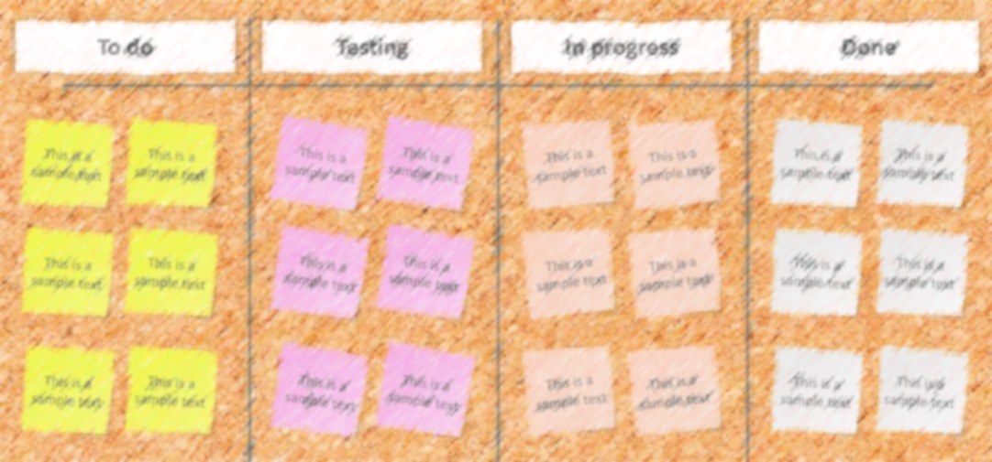
Student Qualifications
Work Study
Work Study students will receive a W-2 every year for time worked as a VA Work Study.
True
False
Knowledge Check #1

Slide 15
Student Qualifications
Work Study
Which statements are the most accurate about student selection? (Select all that apply)
    A. Service-connected disabilities have priority
    B. They do not need to exhibit financial need
    C. Must have availability to transportation
    D. Work assignments don’t conflict with disability
Knowledge Check #2

Slide 16
Work Study Contracts
Agreement Process
Approval Process
Hours of Service
Contract Extensions
Zero Hour Extension
Notes:
Next, we’ll discuss how Work Study contracts are determined and written.​

Slide 17
Agreement Process
The approved work site finds a student; or a student finds a work site willing to bring them on.
The student completes the Application for Work Study Allowance
(VA Form 22-8691).
The work site will send the completed student application to Work Study (WS).
Work Study will review the application and if approved, send the Time Record (VA Form 22-8690), and Student WS Agreement
(VA Form 22-8692).
The site supervisor will obtain the student’s signature on the Student WS Agreement and return it to Work Study.
The site supervisor will send completed Time Records and future contract requests to Work Study.
Notes:
Here’s a general overview of the Work Study contract request process. ​
The approved work site finds a student; or a student finds a work site willing to bring them on. VA Work Study does not place students at work sites. It is up to the work site to advertise open Work Study positions, follow the student selection criteria, and select Work Study students for their work site. It is recommended that you treat this as you would any other position. Advertise the position on a student website or board, accept resumes, conduct interviews, and select a student for your site’s available position based on the student’s qualifications, while adhering to the selection criteria for the Work Study program .
The student’s 22-8691 is good for 1 year from the original start date, unless they’re switching benefits or work sites. ​
​

Slide 18
Approval Process
If Approved:​
Contract and time record sent to site supervisor​
Time frame and number of approved hours​
Students may not begin working prior to VA approving the contract​
If Denied:​
Denial letter sent to student​
Courtesy email sent to site supervisor​
Notes:
• Once a contract request is approved by Work Study, the Student WS Agreement (22-8692) and Time Record (22-8690) are sent to site supervisor via email.​
• Applications may be submitted to Work Study up to 45 days before a term begins. ​
• Contracts may start up to 30 days before the term begins as long as Work Study has approved the contract. This allows the student a larger timeframe to work allotted hours. ​
• This additional time, up to 30 days, will automatically be given if the contract is processed before the term begins and it doesn’t overlap with a previous contract. The student will not receive additional approved hours for this extra time. ​
• A Work Study contract is written based on eligible enrollment that has been processed.​
• The 22-8690 and 22-8692 list the time frame for working and the number of approved hours.​
• Students may not begin working prior to VA approving the contract.​
• Any hours worked prior to approval, after a contract ends, or are in excess of the approved hours CANNOT be paid.​
​
If a WS contract is denied then a denial letter will be sent to the student and an email is sent to site supervisor. These documents list the reason for the denial. ​
​

Slide 19

Hours of Service
25 hours per week, prorated for partial weeks
Can be up to one (1) year or 1300 hours
Not limited to number of hours in a day or week
Not eligible for overtime pay​
Monday
Tuesday
Wednesday
Thursday
Friday
Covered under Worker’s Compensation laws
Notes:
• The number of approved hours for a contract are figured by calculating 25 hours per week of eligible enrollment; these hours are prorated for partial weeks ​
• Contracts can be written for up to one (1) year in length, based on eligible enrollment that has been processed, for a maximum of 1,300 hours ​
• Students are not limited to the amount of hours they work in a day or week. This is up to site based upon the site’s workload, the student’s availability, the site’s working hours, etc. ​
• The student is not eligible for overtime pay.​
• Covered under Worker’s Compensation laws while performing work under a Work Study contract – contact Work Study if you have a student injured while on the job for guidance on what paper work to fill out. ​
​
Example of a contract- ​
A contract has been approved for the term 1/15/24 through 5/15/2024 and has allotted the student 400 hours to work by 5/15/2024. The student has worked all 400 hours by 4/30/2024. There will not be any new hours allotted until after the contact ends on 5/15/2024.​
​

Slide 20
Contract Extensions
A continuation of the original agreement ​
A contract extension can begin up to 30 days before the next term begins​
All hours from previous contract not worked by the END DATE are forfeited​
Contract extensions requests can be submitted through the GI Bill ® Ask VA site​
Must be approved by VA
1 year
From Original Contract Start Date
22-8691
Notes:
• The Work Study Application, 22-8691, is good for 1 year from the original contract start date. The original contract is written based on enrollment that has been processed. Therefore, contract extensions can be requested by the site for future terms within that 1 year. Extensions are a continuation of the original contract agreement and are based on eligible enrollment that has been processed. ​
• A contract extension can begin up to 30 days before the next term begins and cannot overlap with another Work Study contract. Contract extension requests can be submitted to Work Study up to 45 days before a term begins. ​
• All hours from a previous contract not worked by that contract’s end date are forfeited.​
• Contract extension requests must be submitted to Work Study and include the contract dates the site is requesting. ​
• The contract extension must be processed and approved by VA Work Study before the student can begin working. ​
• The contract extension time record and signed agreement will reflect the correct start date and approved hours. ​
​
For Example: An original contract has been approved for the term 1/15/24 through 5/15/2024 and has allotted the student 400 hours to work by 5/15/2024. The student has a qualifying term on file beginning 6/15/24 to 7/15/24. The site can request an extension for this summer term up to 45 days before that term begins. The extension contract can begin up to 30 days before the summer term begins as long as the request is submitted and approved by VA Work Study in time, and the contract does not overlap with another Work Study contract. ​
​
​

Slide 21
Zero Hour Extension
Not to be used when out of hours on previous contract
Used at the end of a contract
WORK STUDY
Additional timeframe to work hours from previous contract
Zero hour extension requests submitted through the GI Bill ® Ask VA site
Does not exceed 30 days from END DATE of previous contract
Work Study will automatically grant up to 30 days after the contract ends unless the site specifically requests otherwise, or there’s a future term
Must be approved by VA

Slide 22
Work Study Payments
Time Records
Payment Parameters
Advanced Payment
Change in Enrollment Status

Slide 23
Time Records
Site Supervisor submits student Time Records on VA Form 22-8690
Time records are processed in order of receipt
Hours should be kept cumulative, initialed, signed, and filled out before starting a new Time Record
Zero-hour time records must continue with cumulative hours from previous time records
Notes:
• Site Supervisor submits student Time Records on VA Form 22-8690
• Time Records are processed in order of receipt
• Time record hours should be kept cumulative, initialed, signed, and filled out before starting a new Time Record
• Zero-hour time records must continue with cumulative hours from previous time records

Slide 24
Payment Parameters
Paid in 50-hour increments or two weeks
VA will not process and pay out “Future Dates”
Paid the higher of either the state or federal minimum wage
Email notification sent to the site supervisor once payment is processed
Hours worked on or after effective date of Department of Labor new rates will be paid at the higher rate
The student can expect payment 3-5 business days after time record processed
Notes:
• Paid in 50-hour increments or two weeks, whichever comes first.
• Paid the higher of either the state or federal minimum wage.
• Once a new rate has taken effect by the Department of Labor, any hours worked on or after the effective date will be paid at the higher rate. The Department of Labor website will have the rates.
• VA will not process and pay out “Future Dates” meaning if the time record was submitted to Work Study on 12/1/25 it must not list work dates after this submission date since that would be in the future and the student has not yet worked.
• An email notification is sent to the site supervisor when the payment has been processed. The email will include the dates of work and amount paid.
• The student can expect payment 3-5 business days after the time record has been processed.

Slide 25


Advanced Payment
Advanced payment is recouped from the first regular payment
Students may elect to be paid in advance for 50 hours in their Work Study agreement
Students must fulfill their requirement within 60 days of starting their contract
Advance payment and time records cannot be processed until the signed contract is received
Notes:
• Students may elect to be paid in advance for 50 hours in their Work Study agreement (field 9 on the Work Study Application, VA Form 22-8691)
• The advance payment is recouped from the first regular payment
• Students must fulfill their requirement within 60 days of starting their contract
• Advance payment and time records cannot be processed until the signed contract is received (VA Form 22-8692). It’s important to know that if your student requested Advanced Payment the student must sign the contract as soon as possible so that the advancement can be released. The site supervisor is responsible for returning a copy of the signed contract to VA. This advance payment will not be processed until the VA Work Study Department has received the signed contract.
• A debt will be established for the student if they don’t work to pay off the advance payment sent to them.

Slide 26

Change in Enrollment Status
Reduction
Termination
In most instances, VA allows the student to continue/finish
Contract stopped at the end of the month of withdrawal
If advancement received, the student is allowed to work until it’s paid
If the pattern continues, VA will notify site and student
Notes:
If enrollment status changes, report it to Work Study Department immediately.
Reduction
In most instances, VA allows the student to continue/finish
If the pattern continues, VA will notify site and student
Termination
Contract stopped at the end of the month of the withdrawal
If advancement received, the student is allowed to work until it’s paid

Slide 27


Work Study Payments
Work Study
25 hours per week, prorated for partial weeks
Can be up to one (1) year or a maximum of 1300 hours
Limited to a number of hours in a day or week
Can only work number of hours approved on contract
Is eligible for overtime pay
Which statements are the most accurate about hours of service? (Select all that apply)
Knowledge Check #3

Slide 28
Work Study Payments
Work Study
A student is enrolled in a term beginning 8/15 to 12/15 and has a Work Study contract for this time period. The student withdraws from the term effective 10/15. The student can work and be paid as a WS student until 12/15.
True
False
Knowledge Check #4

Slide 29
Supervising Students
Tracking
Performance/Conduct
Notes:
Over the next few slides, we will discuss tracking student contract information and review information on performance and conduct.

Slide 30
Tracking
Work Study
There’s no one answer for this. It depends on the work site.
How should a work site track its Work Study students?
Let’s go over an example of what a site can use to track all aspects of its Work Study program.

Slide 31
Example 1: Tracking Template
Notes:
Example 1: Tracking Template tracks Ask VA inquiry submissions for students to include:
Work Study student
the type of document
document’s time period
inquiry number
who submitted the inquiry
has the inquiry been resolved
is further action needed
note section to describe action needed
This is useful to track submissions to VA Work Study especially across multiple supervisors. You could make the tracking document a shared documents for all Work Study site supervisors.

Slide 32
Example 2: Tracking Template
Notes:
Example 2: Tracking Template tracks student contract information to include:
Work Study student
Work site area
Work Study ID or Agreement Control Number (ACN)
original contract or # of extension
contract Start Date
contract End Date
# of days remaining in the contract period
# of hours student has completed
# of hours remaining within the contract period
note section for additional information
This tracking template is useful for an at a glance look at all Work Study students to review their contract end date and contract hours. It will also assist in knowing when to submit an extension or zero hour extension request, to include if you need to request specific dates.

Slide 33
Performance/Conduct
A work site needs to have parameters in place to properly address conduct or performance issues. The frequency and severity of the issue should be taken into account when addressing such issues.
Work Study
What if a student is having performance or conduct issues?
Let’s cover some examples of what your site can implement to address performance and conduct issues.
Notes:
Supervisors should ensure Work Study students are held accountable for their conduct and performance.
If a Work Study student cannot meet the conduct or performance standards, then the site should take appropriate action, after investigating all the facts, to hold the student accountable. The results of failing performance or conduct may include terminating the student’s Work Study contract.

Slide 34
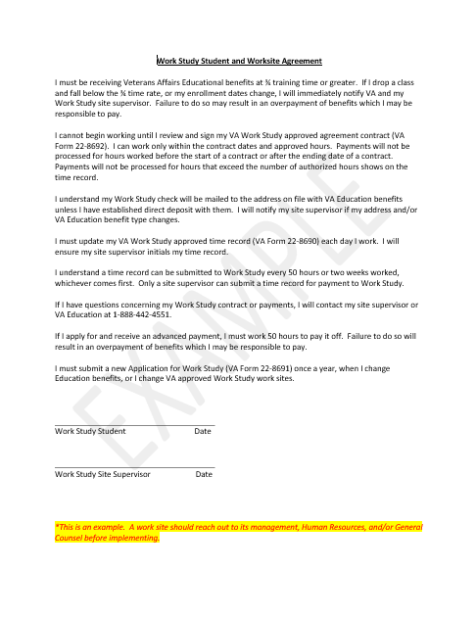


Example 1: Performance/Conduct
Agreement
The student and work site agreement covers the basics of student’s responsibilities and the Work Study program.
Notes:
The student and work site agreement covers the basics of student’s responsibilities and the Work Study program. Let’s go over this document in detail.
There is a link to the sample document on this PowerPoint slide that you can use as a template.

Slide 35
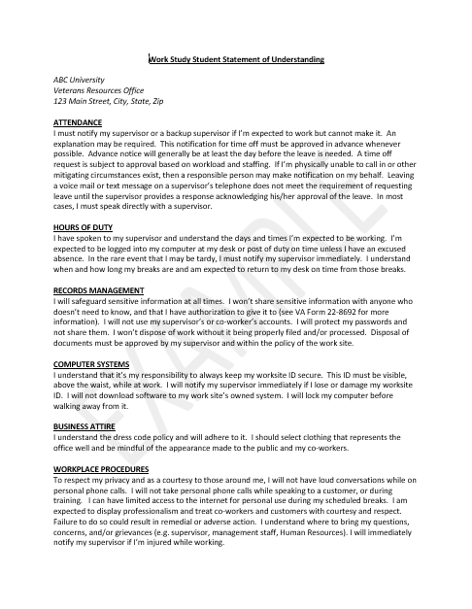
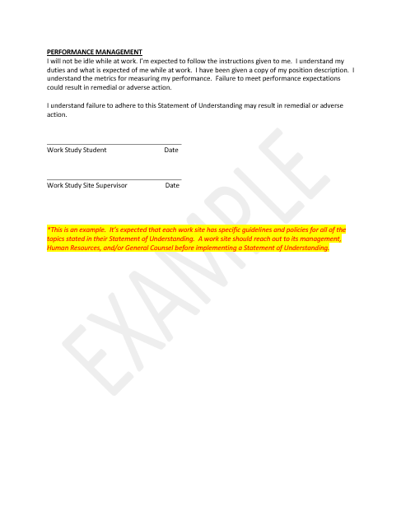

Example 2: Performance/Conduct
Student Statement of Understanding helps to cover conduct issues.
SoU
Notes:
The Student Statement of Understanding helps to cover conduct issues. Let’s go over this document in detail.
Note- Hours of duty and being flexible with the students and communicating this with them.
There is a link to the sample document on this PowerPoint slide that you can use as a template.

Slide 36
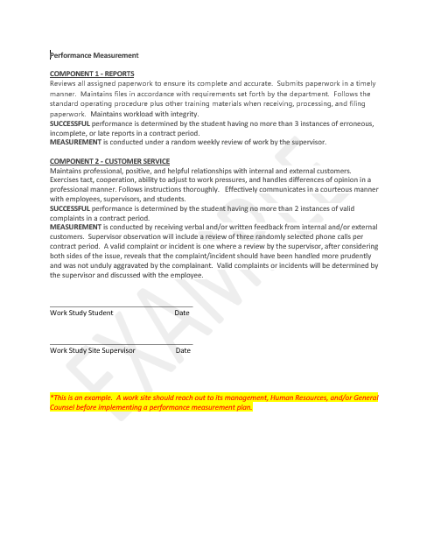
Example 3: Performance/Conduct
Measurement
Performance measurement covers expectations and metrics used to evaluate the student’s performance.
Notes:
Performance measurement covers expectations and metrics used to evaluate the student’s performance.
There is a link to the sample document on this PowerPoint slide that you can use as a template.

Slide 37
REMINDER….
DOCUMENT!
DOCUMENT!!
DOCUMENT!!!
Notes:
It’s important to keep good records. Also, any meeting you have with a student concerning conduct or performance should have the meeting notes shared with the student. You may have to bring in a 3rd party for meetings to help document the meeting notes.

Slide 38

Common Questions
Work Study

Slide 39
Common Questions
QUESTIONS:
Can a Work Study student do homework or study while working?
Can a Work Study student be paid to travel to and from the work site, from one location to another on campus, or to an outreach event?
ANSWER:
No, Work Study students working at an educational facility can perform the following tasks-
Preparation and processing of necessary Veteran related papers and other documents at educational institutions, and the gathering of information to fulfill reporting requirements.
Assisting with dissemination of general information regarding Veteran benefits and/or services and providing assistance to individuals in obtaining these benefits.
Aiding Veteran students with general inquiries about Veteran benefits via phone, email, or in person.
Maintaining and organizing Veteran related files.
Outreach activities which involve the distribution of information about VA benefits to VA beneficiaries or potential beneficiaries and providing assistance to them in obtaining these benefits; distributing information about other governmental programs beneficial to VA beneficiaries or potential VA beneficiaries.
Notes:
Please remember that a Work Site Application, VA Form 22-10219, must be submitted yearly, or earlier if one of the following exists:
• the duties change
• the work site location changes
• your site needs more than a 10% increase in its approved hours. If your site needs a 10%+ increase in your approved hours, then you must state why you need this increase.

Slide 40
Common Questions
QUESTION:
Are Work Study students able to work remotely?
ANSWER:
Yes, however, the work site still needs to adhere to the student selection criteria, provide direct supervision, and the student must still work only on approved tasks listed on the 22-10219/position description.
Notes:
When it comes to student selection, the following factors need to be carefully evaluated:
• Students with service-connected disabilities have priority (30% or more)
• Financial need
• Availability of transportation
• Motivation
• Work assignments don’t conflict with disability or are accommodated. Each facility must ensure that the work assignment is compatible with the student’s service-connected disability. If the disability is discovered after placing the student, try to accommodate the individual as you would a regular employee. You may consult your local HR or contact VA Work Study Department if you have questions.

Slide 41
Common Questions
QUESTION:
Can the student be paid for the training they need to perform their job?
ANSWER:
Yes, Site supervisors are responsible for ensuring their students are trained to perform the tasks listed in their approved position description. Training for Work Study assignments should not exceed more than 20% of the authorized Work Study hours for the specified contract period. Training must be 100% related to their position as a Work Study student.

Slide 42
Common Questions
QUESTION:
Can a work site subsidize a student’s wage?
ANSWER:
Yes, a student who receives Work Study allowance and is assigned by VA to perform Work Study services at a school, may be paid separately by the school at a rate reflecting the difference between the amount payable by VA and the amount which the school otherwise pays to non-VA Work Study students performing similar services.
Notes:
• Please check with your site’s Human Resources and/or management for guidance/concerns/issues if you decide to subsidize Work Study student wages.
• Work Study students can’t receive compensation from multiple sources for the same Work Study hours worked. In other words, work sites shouldn’t be double paying the students.
• The work site should keep records indicating why and how they’re subsidizing the wage.
• Any amount the student receives for subsidizing the wages may be considered taxable income. The work site will need to provide proper tax documents to the students and ensure they’re following all laws/policies/rules associated with this.

Slide 43
Common Questions
QUESTION:
A Work Study student is applying for a loan and needs verification of employment. Can Work Study provide this?
ANSWER:
Work Study can provide a history of the payments the student has received. Furthermore, it’s suggested the student also submit a copy of his or her current contract.

Slide 44
Common Questions
QUESTION:
My Work Study was injured on the job. What should I do?
ANSWER:
Document what took place. Workers’ compensation claims need to be filed on a CA-1 via ECOMP on the DOL-OWCP website. Attach a copy of the most recent/current Work Study contract, any medical documents on behalf of the student, and the student’s position description.
Site Supervisors may use the following email address when filling out the information on ECOMP: WORKERSCOMP.VBAVACO@va.gov
Notes:
Work Study students performing duties at their assigned work site will be considered a VA employee for the purpose of receiving benefits under the provisions of (Compensation for Work Injuries) Chapter 81 of title 5, U.S.C. As such, they are entitled to compensation benefits due to personal injury sustained while in the performance of duty or compensation for employment-related disease.
The Office of Workers' Compensation Programs (OWCP) of the U.S. Department of Labor (DOL), administers, interprets, and ensures compliance with the Federal Employees’ Compensation Act (FECA) and is the sole adjudicator of all workers’ compensation claims for Veterans’ Benefits Administration (VBA) employees.

Slide 45
Common Questions
QUESTION:
Can Work Study hours be paid for those students affected by an emergency situation?
ANSWER:
Work Study payments may be made under Public Law 117-333. In the case of someone who’s in receipt of Work Study allowance as of the date on which an emergency situation occurs and who is unable to continue to perform the qualifying Work Study activities, Work Study may be paid during the period of such emergency situation. Work Study may be paid up to 4 consecutive weeks from the school close date due to the Emergency Situation; or, the end of the Work Study contract, whichever is earlier. In situations where the student has requested advanced payment, Work Study may also award those where applicable. The student may not be paid more than 25 hours per week during the period of an emergency situation. An emergency situation means a situation that the President declares is an emergency and the Secretary determines is an emergency for purposes of the laws administered by the Secretary.
If your student has met this criteria, then you may submit the student’s Work Study approved Time Record, VAF 22-8692, with the following: the name of the declared emergency situation in field 8 “REMARKS”; the begin and end (if known) dates the student was affected in field 8 “REMARKS”, and, field 7 “DATE”; and, enter the number of hours the student would have worked in field 7 “NO. OF HOURS”. All other fields on the VAF 22-8690 must be filled in like normal (e.g. CUMULATIVE TO DATE, INITIALS, SUPERVISOR SIGNATURE).
Notes:
Public Law 117-333.

Slide 46
Common Questions
QUESTION:
Can my work site manage the payment of all time records for it’s students?
ANSWER:
There’s a voluntary program that allows an educational facility to do this…
Notes:
Let’s cover the basics of Public Law 116-154, Improvement to Work Study Act.

Slide 47
Public Law 116-154
Improvement to Work Study Act
Allows a 154 Administering Facility (154AF) to pay Time Records to GI Bill students at their facility
A 154AF can be an approved education facility with a Facility Code assigned to it and students receiving GI Bill benefits at that institution
A Non-154 Administering Facility (non-154AF) is an approved VA Work Study work site that is not approved to administer the payment of Work Study benefits
Students enrolled at 154AF educational institution and is a Work Study at a non-154AF work site; the non-154AF cannot opt-out of 154AF certification and payment system
Approved 154AF will receive a lump sum amount which must be used to pay VA Work Study students only
An educational institution wanting to be 154AF must complete and submit PL 116-154 Participation Form, 22-10270, within the open enrollment period and submit a Position Description with a 22-10219
Academic year and funding: August 1st to July 31st
See the link on the Resources page of this presentation for more in-depth training on PL-116-154
Public Law 116-154 Improvement to Work Study Act Training Video

Slide 48
Resources
Things to remember
Site Supervisor Guidance Page:
Work Study Site Supervisor Guidance - Education and Training (va.gov)
Work Study Site Supervisor phone number:
1-855-225-1159, option 2
Work Study students may call:
1-888-442-4551
Ask VA website: https://ask.va.gov/
Notes:
The Site Supervisor Guidance Page includes links to training videos for understanding Work Study contracts, payments, supervising students, and Work Study work site and student eligibility.

Slide 49
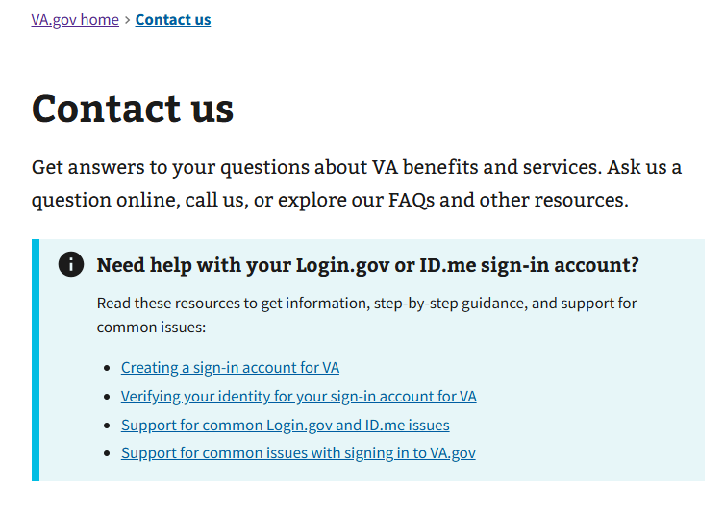
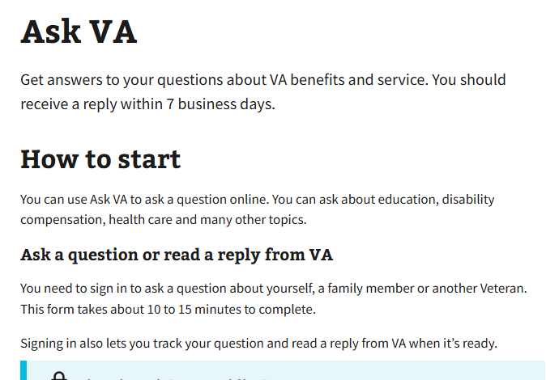
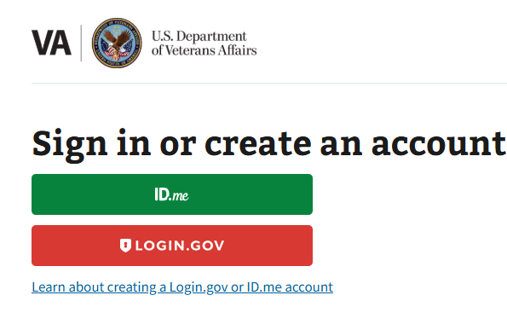
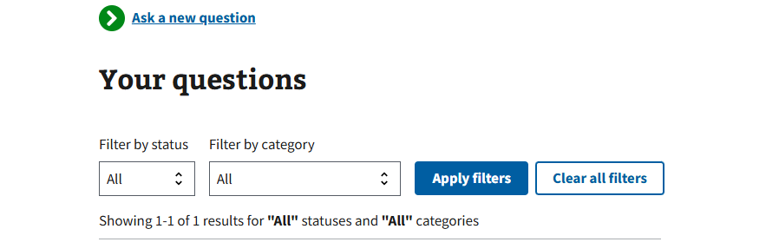
Submitting VA Work Study Documents
Ask VA (AVA)
https://ask.va.gov/
Secure Sign In
Notes:
All Work Study documents should be submitted through the GI Bill “Ask VA” (AVA) website.
You may go to the https://ask.va.gov/ website in order to set up an account and submit Work Study documents and questions.

Slide 50
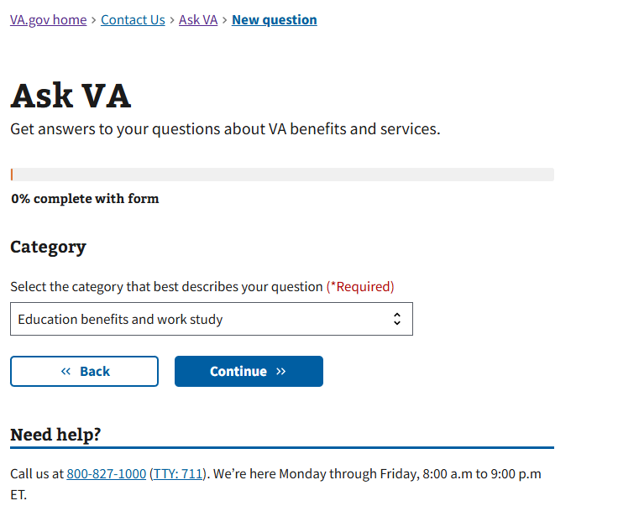
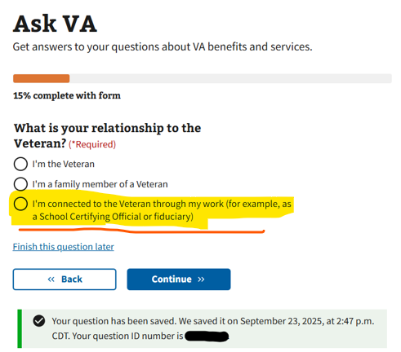
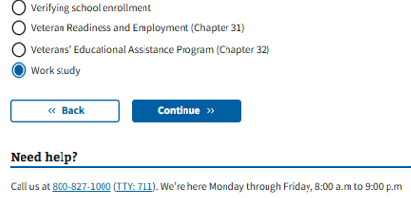
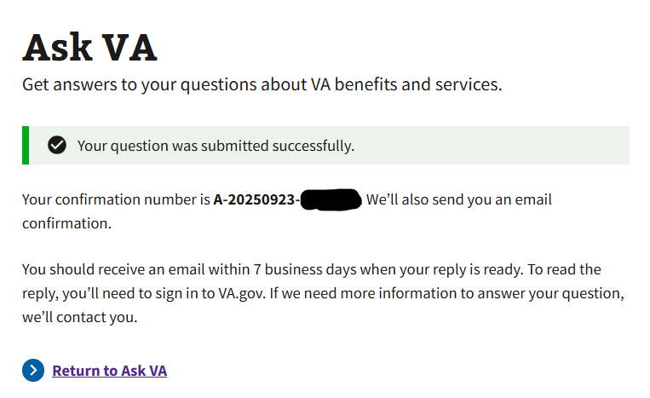
Ask VA (AVA) Submission
Notes:
Select “Education benefits and work study” as the Category
Select “I’m connected to the Veteran through my work…”
Select your role. For example, “Work study site supervisor”
Select “Work Study” as the Topic
Select the Subtopic – “Application” to submit 22-8691 or extension requests; General question for a general Work Study or claimant specific question; "Position description” to submit a 22-10219/Position Description or Site Supervisor update Form; Signed contract to submit a 22-8692; or Time card to submit a 22-8690.
Select the State of facility
Enter your subject line/question/remarks
Upload attachment(s)
Submit
You’ll receive an email when your submission goes through and another email when you receive a response from VA.
NOTE: you can submit a signed contract and time record on the same AVA inquiry submission as long as it’s for the same student. You can submit a zero hour and extension request on the same AVA inquiry submission as long as it’s for the same student

Slide 51

Thank You
51
Notes:
Thank you for your time.

