Slide 1
Veteran benefits and financial aid
Casey Lehmann – Nicolet college – financial aid manager

Slide 2
Question 1:
How do VA education benefits impact other financial aid awards?

Slide 3

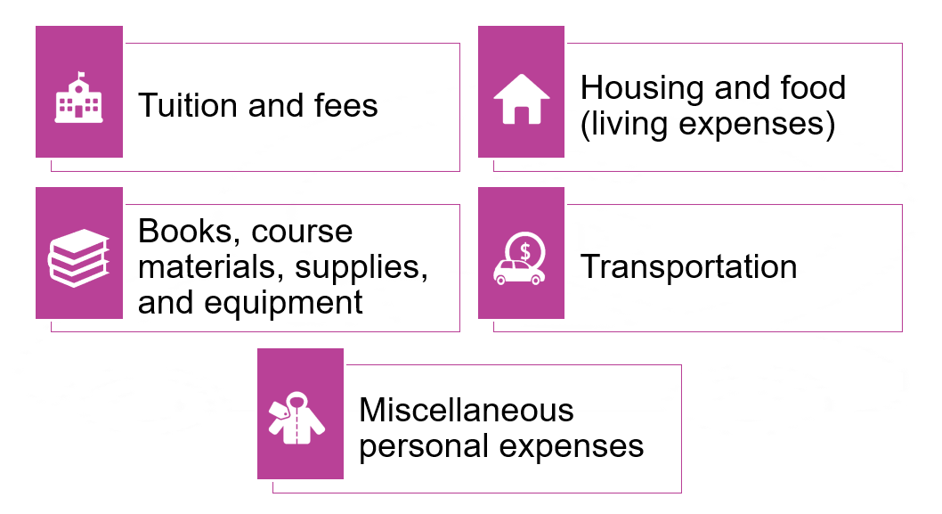
Let’s start with the basics
Cost of Attendance
Also known as the student’s budget
School’s best estimate of the costs a student will incur during a specified period of enrollment.
Generally, cannot award financial aid over cost of attendance
Cost of attendance – student aid index = financial need

Slide 4
Federal vs. state Va education benefits
Federal va education benefits plus other financial aid may exceed a student’s cost of attendance
State va education benefits plus other financial aid may not exceed a student’s cost of attendance

Slide 5

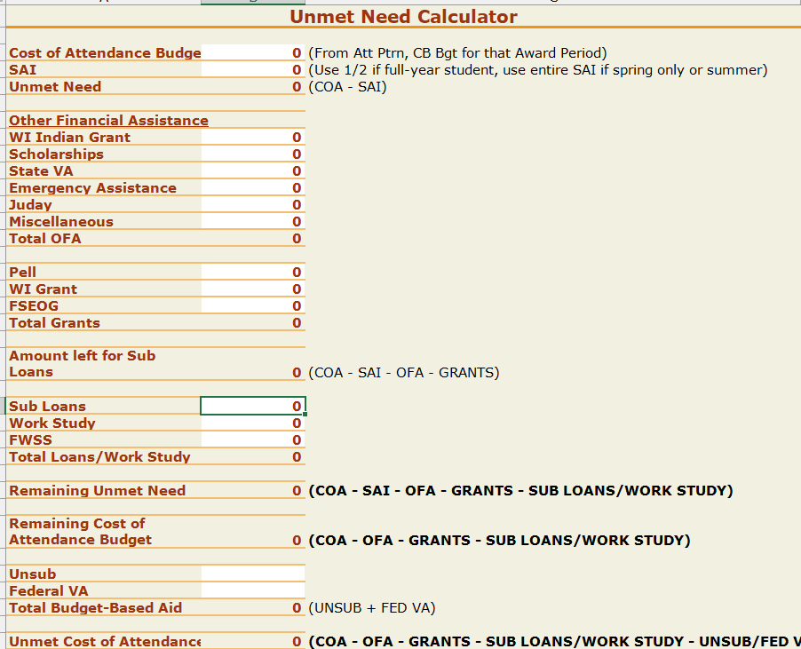
STATE VA BENEFITS ARE INCLUDED IN THE CATEGORY OF OTHER FINANCIAL ASSISTANCE
CAN MAKE A DIFFERENCE AS TO WHAT LOANS A STUDENT IS ELIGIBLE FOR

Slide 6
THESE FEDERAL EDUCATION BENEFITS HAVE NO IMPACT ON A STUDENT’S TITLE IV AID ELIGIBILITY:
Chapter 1606
Chapter 30
Chapter 31 chapter 33
Chapter 35 ignore above benefits for title iv purposes not counted as other financial assistance not reported on fafsa so not in federal need analysis

Slide 7
changes to federal pell grant eligibility
Beginning July 1, 2026, students who receive aid other than pell than exceeds their cost of attendance will no longer be eligible for a pell grant even though they would otherwise be eligible.
Does not include federal va education benefits
Could affect students receiving wi gi bill should they also receive other scholarships

Slide 8
Financial plan for VA students

Slide 9
Questions?

