Slide 1

Onboarding a New SCO
Presented by Jackie Leon, Chris Smith, Dennis Rhodes​
1

Slide 2
Agenda
Steps required to get set up for Federal Benefit Processing
Steps required to get set up for State Benefit Processing
Making sure the SCO is connected
Tips, tools lesson’s Learned
Q&A
2

Slide 3

Introduction
Jackie Leon
Director Veteran Services
Western Technical College
Phone: 608-785-9091
Email: leonj@westerntc.edu
Dennis Rhodes
Director for Student Veteran Affairs
Universities of Wisconsin
Email: dennis.rhodes@wisconsin.edu
Phone: 608- 261-1434
Christopher Smith
Veteran Services Program Manager
University of Wisconsin-Stevens Point
Phone: 715-346-2687
Email: chsmith@uwsp.edu
3

Slide 4

Federal VA Education Benefits
4

Slide 5

Certifying students’ enrollment dates, credits, clock hours, and/or hours trained
Reporting changes like withdrawals, enrollment reductions, graduation, or program completion
Responding to inquiries from VA about student certifications
Maintaining documentation and records to support every certification
Following current VA policy, including annual training and compliance rules
Depending on your type of institution, your duties might also include:
Tracking student attendance or satisfactory progress
Documenting on-the-job or flight training hours
Submitting additional documentation for certain benefit types
SCO responsibilities include:

Slide 6
Federal SCO Onboarding Workflow
VA Form 22-8794 → Required Training → Upload Documents → VA Education Platform → Enrollment Manager Access → Certify Students
24

Slide 7
Getting started
1. Complete VA Form 22-8794
  VA uses the Designation of Certifying Official(s), VA Form 22-8794 to officially authorize and SCO.
  Fill out the form and have it signed by your organization’s leadership. All designated certifying officials must be listed on this form every time it is submitted to VA.
  2. Complete Required Training
  SCO will need to complete the mandatory online training specific to organization type. Training is available through VA’s SCO Online Training Portal You’ll need to create an account. Once training is completed, download the certificate of completion.
  Once you’ve gathered both the completed form and certificate, use the Education File Upload Portal to submit your designation package securely. This will be sent to the Education Liaison Representative (ELR)
  3. Create a VA Education Platform Account
  This requires signing in with either Login.gov or ID.me. Help with ID.me: https://help.id.me/hc/en-us
  Help with Login.Gov : https://www.login.gov/help/
  4. Request Access to Enrollment Manager (EM)
  Bookmark the login page. Once the designation is complete you will use your credentials to access EM.
  5. Sign up for GovDelivery email subscription
  VA shares important updates and announcements—such as system changes, reminders, webinar and training opportunities, and policy guidance—through its GovDelivery email subscription service.
  Staying informed is key to supporting your students and remaining in compliance.
  Note: Be sure to select “EDU School Certifying Officials” as your subscriber group to get the right updates.
  6. Set up Ask VA Account
  Get answers to your questions about VA benefits and service. https://www.va.gov/contact-us/ask-va/introduction
5

Slide 8
Bookmark Pages For Federal Benefits
SCO Handbook | Reference for policy, procedures, and compliance | SCO Handbook Link
SCOOP- School Certifying Official Onboarding Preparation | Series of onboarding webinars designed specifically for New SCOs. Sessions are grouped by program type (IHL, NCD, OJT/APP, Vocational Flight) and offer step-by-step guidance to help you begin certifying confidently. | Scoop Training page
SCO Online Training Portal | Complete your required training | https://vba-tpss.vbatraining.org/assess/trkSignIn?refid=XSCO
VA Education Platform | Access to Enrollment Manager where students are certified for benefits. | Platform Link
EM User Guide | Enrollment Manager User guide | EM User guide
Education File Upload Portal | This site is for School Certifying Officials (SCOs) to upload documents supporting Compliance Actions | https://www.my.va.gov/EducationFileUploads/s/
6

Slide 9
Continued Bookmark Pages For Federal Benefits
DOD MOU | Department of Defense Memorandum of Understanding | https://www.dodmou.mil/login
AI portal | Army and Air Force Tuition Assistance Portal | https://aiportal.us.af.mil/aiportal/Account/ConsentToMonitor
Army Knowledge Online | Army TA support community | https://military-school-support.mn.co/spaces/9297619/feed
Tungsten | Access purchase orders for Chapter 31 Veteran Readiness & Employment students. | https://portal.tungsten-network.com/
AIM Portal | Navy and Marine Tuition Assistance Portal | https://myeducation.netc.navy.mil/school_portal
SpouseWorks | SpouseWorks Scholarship (formerly MyCAA) is a workforce development program | https://mycaa.militaryonesource.mil/mycaa/school-resources/for-institutions
ASKVA | Get answers to your questions about VA benefits and service. Submit VA Work Study Timesheets and paperwork. | https://www.va.gov/contact-us/ask-va/introduction
Debt Management | Call School Debt Line: 833-870-2574 (for Post-9/11 GI Bill tuition/fees/Yellow Ribbon debts only). | https://www.va.gov/manage-va-debt/
ACE Military Guide | The ACE Military Guide supports academic institutions in awarding college credit to military-connected learners based on their military training and ​​occupations. | https://www.acenet.edu/Programs-Services/Pages/Credit-Transcripts/military-guide-online.aspx
GI Bill Comparison Tool | Programs approved for Veterans benefits. Includes exams, licenses, certifications. | https://www.va.gov/education/gi-bill-comparison-tool/institution/11000849
VR&E Chapter 31 Handbook | Veterans Retraining and Employment Program | Handbook Link
7

Slide 10
Help your New SCO Prepare for Compliance
Know what will be expected to provide.
  Financial Aid- Finance Plans
  Student Acct Ledger
  Transcripts
  Marketing Materials –college wide
  Policies
  Admission information
  Enrollment & schedules
  All Certification documents, amendments & terminations
8

Slide 11

State Benefits
9

Slide 12
Wisconsin State Benefits Workflow
SAA Approval → VBATS Access → WIGI Bill Portal Access → Benefit Processing → Reporting & Compliance
25

Slide 13

Delivering with confidence
SCO Responsibilities to the State Approving Agency (SAA
What’s expected of you when it comes to program approval and compliance. Importantly, you must notify the SAA of changes such as:
New or revised programs and courses
Changes to tuition and fees
Changes in school or training institution name, ownership, or location
Changes in accreditation status
Changes in Title IV eligibility (e.g., placed on heightened cash monitoring)
Significant changes in instructional format (e.g., moving from in-person to online)
Changes in policy that directly relate to SAA approval related criteria.
10

Slide 14
Bookmarks For State Benefits
National Guard Grants | Wisconsin National Guard Grant Portal | https://widma.powerappsportals.us/
Vet Ed | Veteran Benefit Application Tracking System (VBATS) Access and track Veteran education grant applications | https://apps.dva.wisconsin.gov/vbats/Account/Login?ReturnUrl=%2Fvbats%2F
MyWisVets | Wisconsin's Veteran Benefits Portal -This tool is intended to assist Veterans in applying for Benefits provided to them by the state of Wisconsin | https://dva.wi.gov/
VBATS | Veteran Benefit Application Tracking System (VBATS) Access and track WI GI Bill | https://apps.dva.wisconsin.gov/vbats/Account/Login?ReturnUrl=%2Fvbats%2F
SAA –Wisconsin State Approving Agency | (SAA) reviews and approves Wisconsin-based program eligibility for the federal GI Bill®, | https://dva.wi.gov/benefits/education/federal-gi-bill/
WICVSO | The County and Tribal Veterans Service Officer Association of Wisconsin (CTVSOAWI) is an organization of professional veterans' advocates. | https://wicvso.org/locate-your-cvso-tvso/
UW Portal – WIGI Bill | Wisconsin GI Bill Data System for Remissions & Supplemental Payments. | https://apps1.wisconsin.edu/wgibill/login
11

Slide 15
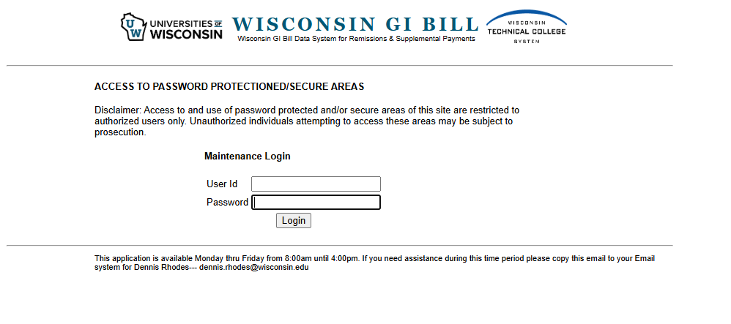
WIGI Bill Portal
12

Slide 16
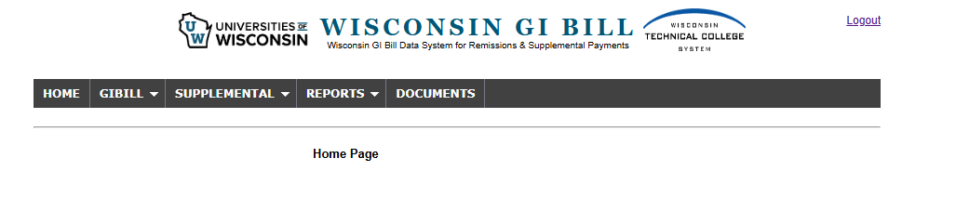
WIGI Bill Data System; aka "the Portal"
WTCS campuses don't see GI Bill section and use Supplemental and Reports sections
UWs maintains and updates supplemental payment calculation tool with new benefit and BAH rates
UWs, through the data-sharing agreement with WTCS maintains data that supports credit reports; students are capped at 128 credits
Credits used under the Wisconsin Veteran's Grant for Private Schools also count against the 128 cap, but these credits are currently not captured in the credit reports
20

Slide 17
Getting Access to the WIGI Bill Reporting Portal
The only official source of remissions, credit, reimbursement, and supplemental payment data for UWs. The source of credit and supplemental payment data for WTCS campuses
Why is this serious business?
Access for any campus staff requires an approved Data Authorization Request (DRA)
Dennis completes WTCS DRAs on behalf of WTC campuses
New UW SCOs must complete a DRA; SCO's supervisor must also approve requests after receiving an automated e-mail from bp-logix@uwss.wisconsin.edu
The DRA process will be delayed if supervisors fail to act on e-mail instructions
SCOs receive a username and password in separate emails per security protocols
Please notify UWSA when authorized users leave or change roles
17

Slide 18
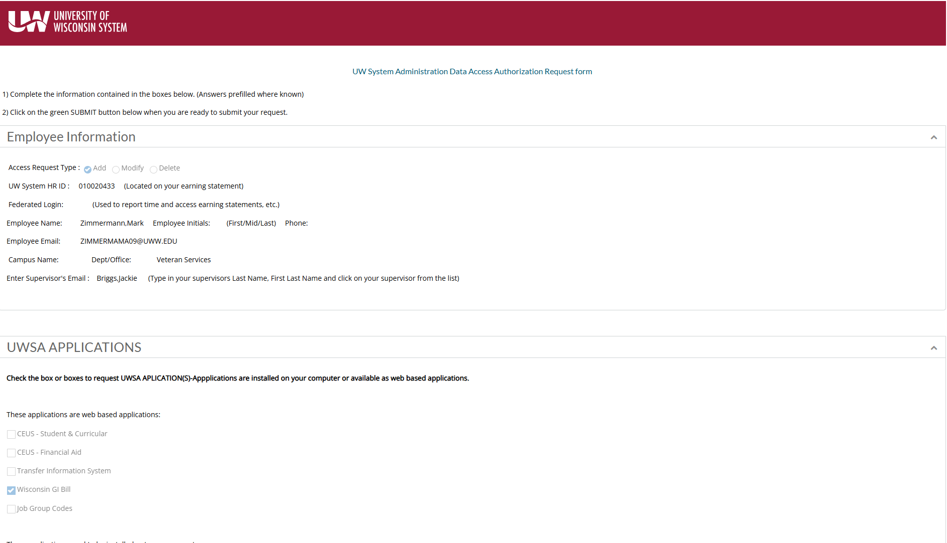

Data Authorization Request
v
18

Slide 19
Access Challenges
Campus IP addresses and related configurations need to be set to allow the portal website address https://apps1.wisconsin.edu/wgibill/login to load
At the same time, UW Shared Services needs to set our systems to allow campuses to access the site
Accessing the site from a home office through a VPN may also require network adjustments
If authorized credential holders can't access the site, Campus IT/Network Administrators need to work with UW Shared Services to resolve issues
19

Slide 20
Starting tips (UW Only)
Have Dennis add you to the "Veterans Certifying Officials" email list and monthly Teams call; keep 2nd Thursday at 10:00 am open for the monthly Teams call for all UW SCOs and interested campus staff
Be open to system universities wide work groups, for example, development of an online and video course for new SCOs or modifications to the
Recent examples of workgroup products include the Veterans Policy & Practice Report and the Military Connected Student Benefits Assessment
21

Slide 21
Important System Contacts for WIGI Bill
WTCS
UW System
Education Directors:
Colleen Larsen, PhD
Director, Student Success
Wisconsin Technical College System
608-266-3738
Colleen.larsen@wtcsystem.edu
Brandon Trujillo
Policy Advisor
Policy and Government Relations
Wisconsin Technical College System Office
608-267-9514
Brandon.trujillo@wtcsystem.edu
Dennis Rhodes
Director for Student Veteran Affairs
Universities of Wisconsin
Email: dennis.rhodes@wisconsin.edu
Phone: 608- 261-1434
13

Slide 22
Tips and Tools
14

Slide 23
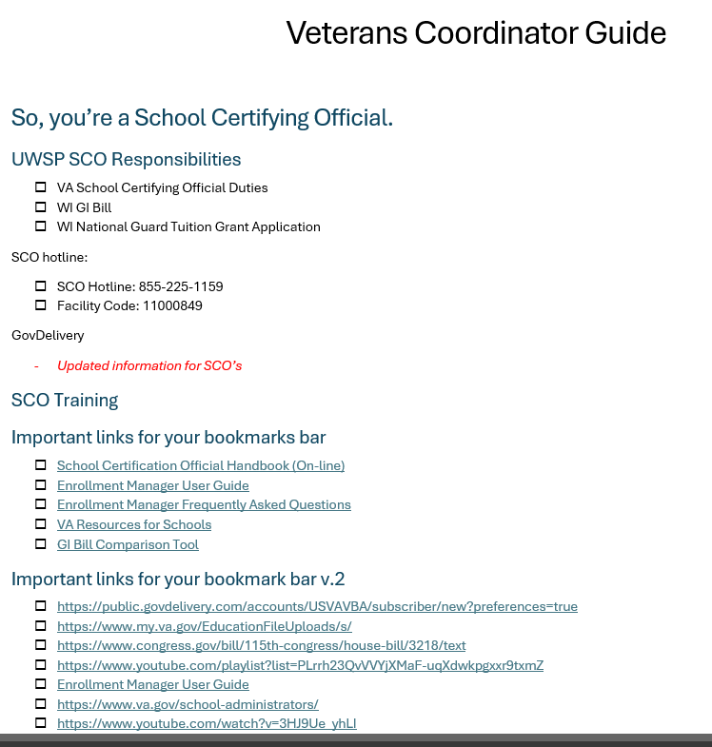
Create Tools for your SCO
SCO Onboarding Checklist
SCO Onboarding Training
SCO Procedures Handbook (School Specific)
Additional Resources
Service Indicator Page
Student Information System Guide for Military Connected Students
Timeline –certification timeline with tasks for reporting
Professional Development Opportunities: NASPA, NAVPA, WAVES, NASAA, SVA, AVECO, WACRAO https://www.benefits.va.gov/GIBILL/docs/NTT-Schools-Training-Calendars/ntts-training-calendar-fy2026.asp
15

Slide 24

Create a Directory of Important Contacts
16

Slide 25

30-60-90 Day New SCO Success Plan
First 30 Days
• Complete training
• Obtain system access
• Meet key contacts
Days 31-60
• Begin certifications
• Review compliance requirements
• Build resource library
Days 61-90
• Conduct self-audit
• Refine processes
• Participate in professional development
23

Slide 26

Q & A
.
22

