Slide 1

Counseling, Case Management &
Early Alert
Brent Brigson, Presenter
Mental health Counselor
EVERY STUDENT EVERY DAY

Slide 2
Western’s Counseling Model
Our Counseling and Case Management team provides short-term support to students facing mental health concerns, life challenges, or crises. We are here to help you handle whatever is making things difficult, so you can stay focused on your goals.
Our mental health practitioners work with students one-on-one to address a wide range of mental health concerns. We focus on helping you build coping strategies, improve resilience, and gain clarity during difficult times that can affect your academic success.

Slide 3
Counselors/Case Manager’s Help With
Mental Health Concerns Related To:
Relationships
Financial
Career/Job Changes
Trauma
AODA/Addiction
Grief
Suicidal Ideation Assessments and Hospitalizations
Basic Need Referrals
Domestic Violence Safety Planning
Mental Health Medication/Therapy Referrals
EVERY STUDENT EVERY DAY

Slide 4
The Student “System”
Student
Faculty/Relationship Owner
External Student Supports/ Case Management
Western Student Supports

Slide 5

Example Student Situation - Triage
Student
Housing Insecurity
Financial Aid
Counseling
Food Insecurity
Veteran’s Benefits
Referral from Faculty
Case Manager coordinates and communicates with all the internal and external providers. Everyone moving in the same direction!

Slide 6

Early Alerts 101
System has been in place for over 10 years
Clearinghouse/central location for formally referring individuals in distress or who need additional supports and resources
Strong reporting culture makes everyone safer
Anyone on campus can fill out an Early Alert
A way for staff to raise their hand in support of their students.
Generally, over1,500 referrals per term (fall, spring, summer)

Slide 7
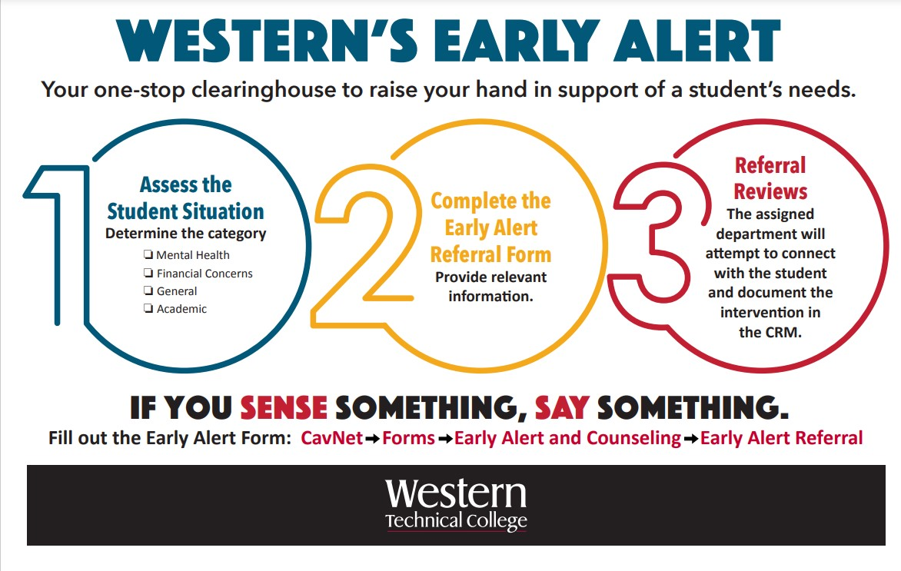
Notes:
Everyone is onboarded with this information and expected to sense something, say something. Reinforced throughout the year.

Slide 8
How to Assess and Refer: INTRANET - https://intranet.westerntc.edu/
https://apps.powerapps.com/play/e/default-5e83780e-47ff-4172-99e4-1a59d71b4020/a/49dd8c7e-74c0-4df9-a472-6c92b6b5879a?tenantId=5e83780e-47ff-4172-99e4-1a59d71b4020
Cavet - Home
EVERY STUDENT EVERY DAY

Slide 9
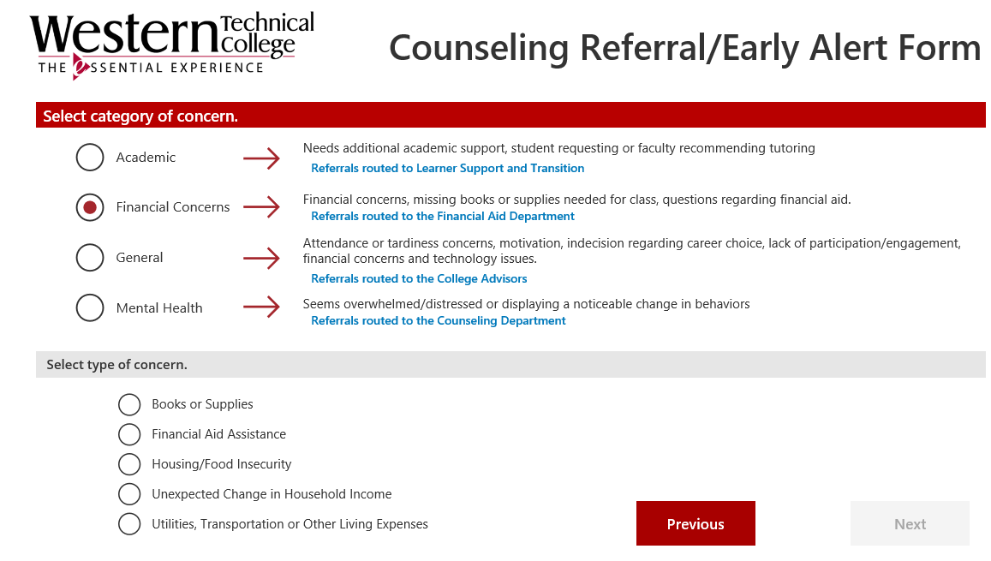
Early Alert Categories
EVERY STUDENT EVERY DAY

Slide 10

Thank you!
EVERY STUDENT EVERY DAY

